Slide 1
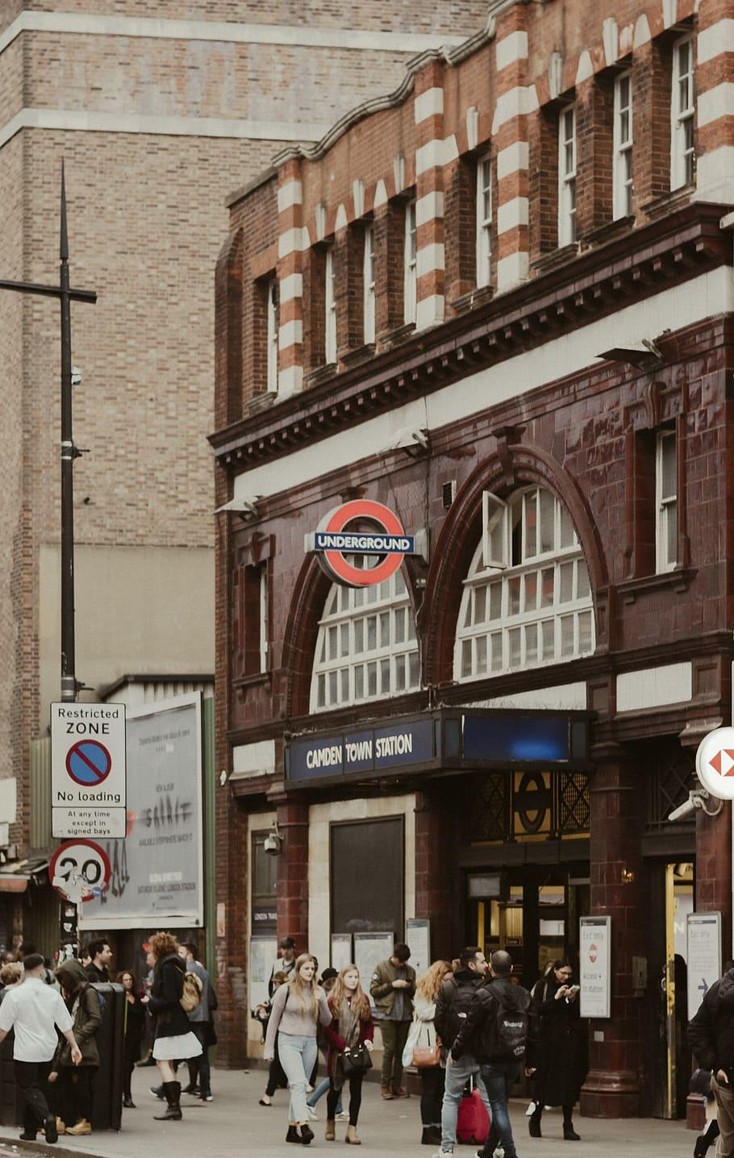
Camden Migration Histories
Resource Pack
Migration Museum
Open City
This work was supported by the Economic and Social Research Council
Grant number ES/T009454/1

Slide 2
Contents
Introduction to Part One 3
How to use this resource 3
Camden Migration Map 4
Case Study One: Irish in London 5
Historical context 5
Irish migration to Britain timeline 8
Key locations in Camden 9
Activities 1-3 10
Resources 12
Case Study Two: Kenwood House & Dido Elizabeth Belle 13
Historical context 13
Activities 1-3 14
Resources 16
Case Study Three: Arthur Rimbaud & Paul Verlaine 17
Historical context 17
Activities 1-3 18
Resources 20

Slide 3
Contents continued
Case Study Four: Little Italy and St Peter’s Church 21
Historical context 21
Activities 1-3 23
Resources 25
Conclusion to Part One 26
Introduction to Part Two - Open City 27
Understanding race, ethnicity and migration 28
Race, migration and social housing in Camden 30
Race, migration and education in Camden 33
Key Words and Definitions 35

Slide 5
Introduction
The Migration Museum in collaboration with the Open City project has created this resource pack to help teachers and learners explore Camden’s rich migration histories.
The London Borough of Camden is rich with migration stories from lots of different time periods. Throughout its history people have arrived here from all over the world, settled and created a home and communities. People's’ reasons for migration have been very varied and their experiences on arrival and settling have also been varied.
The Migration Museum - https://www.migrationmuseum.org/ - explores how the movement of people to and from Britain across the ages has shaped who we are – as individuals, as communities, and nations. We explore migration through our exhibitions, events and our learning programme. We are currently based in a shopping centre in Lewisham, but are working towards a permanent home in the City of London from September 2026. Please join our mailing list to keep in touch with us.
The Open City project is a collaboration between researchers at four universities: The University of Warwick, The Open University, The University of West London and The University of Oxford. The Open City project looks at the social and political life of London to test whether the utopian ideal of the Open City exists in real life and explores issues of race, migration, mobility and living with diversity. You can find out more on their website: www.opencitywarwick.co.uk
How to use this resource pack
As Camden is a borough which is rich in migration stories, rather than attempting to cover the whole history of migration in Camden, we have chosen to focus in on some of the many communities and migration stories in Camden in part 1 of the pack. We have tried to provide historical context for each case study, but We hope that you and your students can add in your own migration stories; this pack is just a starting point.
This pack can be used in many different ways. As a whole, it can be used to get an overview of the diversity of the borough of Camden, understanding how race, ethnicity, migration, community and housing intersect here. Or different sections of the pack can be used in isolation to explore topics in depth. For example, you could take a single case study and explore this over the course of a lesson. In addition to the case studies you can also find a migration history map of Camden, which you can use to explore the stories interwoven into the streets around us.
We hope that however you use the pack it is informative and helps you and your students better understand this rich and fascinating part of London.
We welcome any questions or feedback you may have. We are always learning when it comes to resource creation and your input will help us to develop resources that are most useful for you and your students. Please get in touch with our learning team via our Senior Learning Manager: Liberty@migrationmuseum.org

Slide 6
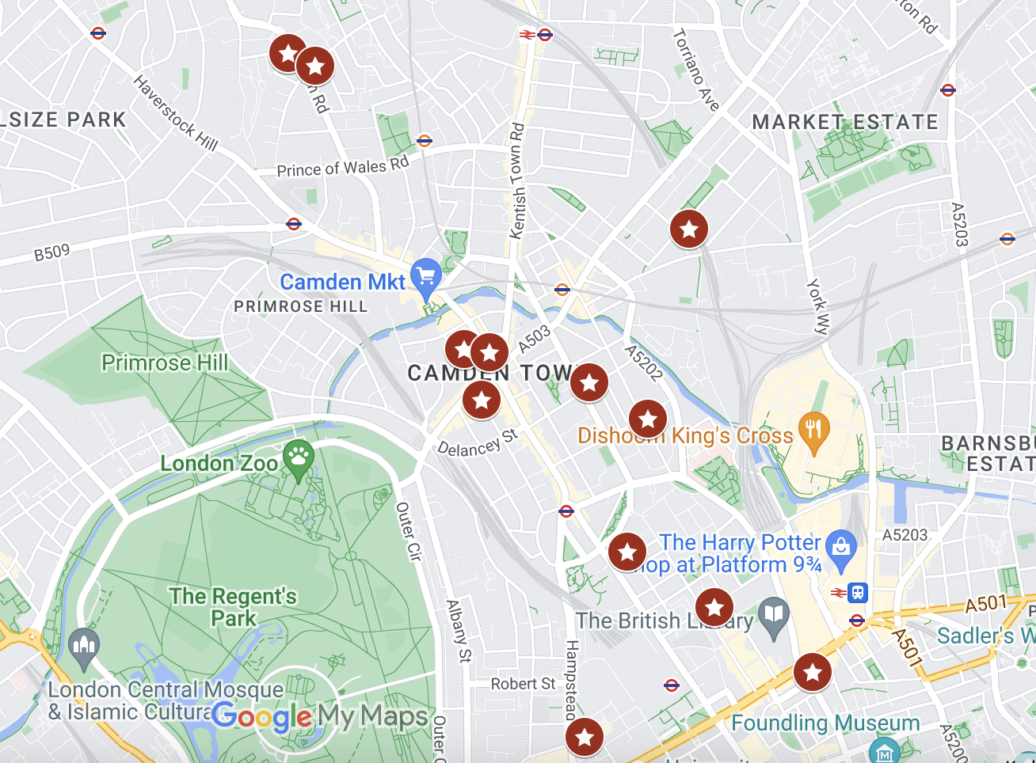
Camden Migration Map
We have created a Camden Migration Map, highlighting some of the many migration stories, historical and contemporary, that are woven into the fabric of the borough. London has always been a vibrant and diverse city, home to people from across the globe – and the borough of Camden is no different, with migration stories shaping the fabric of its streets and buildings. We hope that this map will illuminate some of these stories and encourage you to continue your journey into learning how migration has shaped us, as individuals and as communities.
We also provide further details about each point on the map in this Camden Migration Map Information booklet. As Camden is such a large borough (5miles long!) we do not recommend trying to walk to all of the stops in one go. Stops on this map can be linked up to create a shorter walking tour or used in the classroom to show the breadth of history on your doorstep.
There is lots of potential to use this map in different ways; you could ask students to do further research on different points on the map, or find histories to add to the map. You could ask students to compare different stops on the map and make connections between them.
Here is a link to the Camden Migration History Map plotted into google:
https://www.google.com/maps/d/edit?mid=1mRyzEtuehx5NFXG4oz25gFcHMLDSTnQ&usp=sharing

Slide 7
Case Study One:
Irish in London
Relationship between Britain & Ireland
Before we start talking about migration from Ireland to Britain it is important to understand the nature of the relationship between the two islands. Ireland has been connected to Britain since the Norman Conquest (starting in 1066), as the Norman Barons seized control of much of Ireland and it was named a ‘lordship’ of the King of England. The English Crown fully asserted control of Ireland in 1541, when the Irish Parliament bestowed the title of King of Ireland on Henry VIII. Thousands of Protestant settlers from England and Scotland arrived in Ireland and displaced many of the existing Catholic landowner; this created tension which would boil over into centuries of conflict. The Irish Parliament was abolished in 1801 when the Act of Union created the new United Kingdom of Great Britain and Ireland. However the second half of the 19th Century saw the movement for Irish independence and the ending of British rule grow in strength. Military violence was seen by many as the only way to achieve independence for Ireland; the Easter Rising in 1916 is perhaps the most famous example of this. The 1919-1921 Anglo-Irish War was followed in 1922 by the partition of Ireland and the creation of the Irish Free State and Northern Ireland. However this did not stop division in Ireland or violence. The Troubles is the name for a prolonged period of conflict in Ireland largely over the status of Northern Ireland. This conflict lasted from 1969-1998. Unionists (who are mostly Protestants) want Northern Ireland to remain a part of the United Kingdom, while Nationalists (who are mostly Catholic) want Northern Ireland to leave the United Kingdom and join a united Ireland. Northern Ireland remains a part of the United Kingdom, while the rest of the island is now known as the Republic of Ireland. However people still have strong feelings about the status of Ireland to this day.
Note: In the information below, when discussing events before 1921 (when the Republic of Ireland was formed, and shortly afterwards the Irish Free State), ‘Ireland’ will refer to the whole country. The term Britain will be used instead of the United Kingdom, as we are talking about migrants from the island of Ireland to England, Scotland and Wales.
Migration from Ireland to Britain
People have been migrating from Ireland to Britain for hundreds of years. This is in part due to geographical proximity but also due to the colonial relationship between the two countries. British rule made living conditions difficult for many in Ireland and many people lived in poverty. Sustained waves of migration from Ireland have meant that the Irish population in Britain is large and in 1971 they were the largest migrant community in Britain.
Key Words
Displaced- A person forced to leave their home, typically because of war, persecution, or natural disaster. You can be displaced within your country of origin
Abolished - To formally put an end to something; a system, practise or institution

Slide 8
Case Study One:
Irish in London
Continued…
Since 1800, approximately 10 million people have emigrated from Ireland, and Britain has been one of the main destinations for Irish emigrants. As the commission on emigration noted in 1955, Irish emigration was ‘a part of the generally accepted pattern of life’.
The following section gives an overview of some of the main waves of migration from Ireland to Britain, giving you a picture of the continuous migration of Irish people to Britain over the past 300 years. Irish people migrated to lots of different areas of Britain; the information below will focus on Irish migration to London. For Camden specific case studies, go to the section on the London Irish Centre and Arlington House.
17th & 18th centuries
Irish immigrants have formed an important part of the London population from at least the early seventeenth century. They were commonly found as seasonal labourers and street sellers. During the 18th century immigrants from County Cork and the west of Ireland were often found living in slums in areas around St Giles in the Fields, in the modern Borough of Camden.
1840 - 1860
There was a large increase in Irish immigration in the 1840s. The number of people who had been born in Ireland and migrated to London was at its highest in 1851, when the census recorded 109,000 people.
People migrated from Ireland to Britain to escape extreme poverty and to find better-paid work. Irish migrants travelled to the big cities, like London, Birmingham and Liverpool, where there were lots of jobs available. Many were involved in building canals, railways and working in factories, mines, cotton mills and docklands.
From 1845-1849, even more people emigrated from Ireland because the Great Famine caused extreme poverty across Ireland. This situation was made worse as some absentee landowners took the opportunity to force small tenant farmers to get off their land in order to grow more efficient crops. Over one and a half million people emigrated from Ireland to escape the famine.
Key Words
Labourers - A person doing manual work e.g. farm work
Slums - A dirty and overcrowded area inhabited by very poor people
Census - An official count or survey, usually of the population
Emigrated - The action of moving away from a country
Absentee landowners - Someone who legally owns the land without actually occupying it or managing it
Tenant Farmers - A person who farms rented land
Notes:
Keys Words
Labourers - a person who does manual work for money, eg. Farm labourer
Slums - an area of housing that is overcrowded and dirty, inhabited by the impoverished people
Census - an official count or survey, especially of a population
Emigrated - the act of leaving your home / country to permanently settle somewhere else
Absentee landowners - a person who legally owns the land without actually occupying it or managing it
Tenant Farmers - a person who farms rented land

Slide 9
Case Study One:
Irish in London
Continued…
Many people believed all Irish migrants were poor manual workers or farmers. However there were also many middle-class migrants who came to Britain and worked as school teachers, midwives, shopkeepers and doctors, for example.
With the development of New Oxford Street in 1847, much of St Giles was demolished and many Irish residents moved north into Camden Town and what was then called Agar Town. Many were engaged in building or manual work, but many others took up work in a range of different occupations.
Roughly one in two people born in Ireland in the nineteenth century emigrated.
Twentieth century
World War II had a big impact on migration. There was a sudden widespread shortage of labour in Britain because of army conscription and British firms went to Ireland to recruit workers.
Example: During World War II the British company Alfred McAlpine appointed an office manager in Dublin to recruit Irish labourers. Of the 10,000 men needed for an underground factory for the British Aeroplane Company, most were recruited at the Dublin office. Local men employed by the company were also sent to County Mayo, Ireland, to hire more people.
Following the end of World War II, Irish workers played an important role in rebuilding roads and buildings in London, which had been heavily bombed. Between 1945 and 1951, around 70,000 to 100,000 Irish people migrated to Britain. A focus of a lot of this construction work was in Camden; this was because Camden had been heavily bombed during World War II because enemy bombers tried to destroy key industrial sites. Camden was home to quite a few of these, for example Kings Cross and Euston stations, the Railway Goods Yard and the canal. By 1946, there were nearly 30,000 Irish workers living in London's industrial hostels, the largest of which was in Camden.
Irish workers were also employed in the National Health Service in the 20th century. Many Irish nurses already worked in British hospitals but when the National Health Service was created in 1948, even more migrated to Britain. By 1971 about 12% of Britain’s nurses were from Ireland. Camden has a number of major hospitals which boosted the Irish population in Camden, for example the Royal Free Hospital and University College Hospital.
Key Words
Army conscription - The compulsory enrollment of persons especially for military service
Notes:
Key words
Army conscription - the compulsory enrollment of persons especially for military service

Slide 10
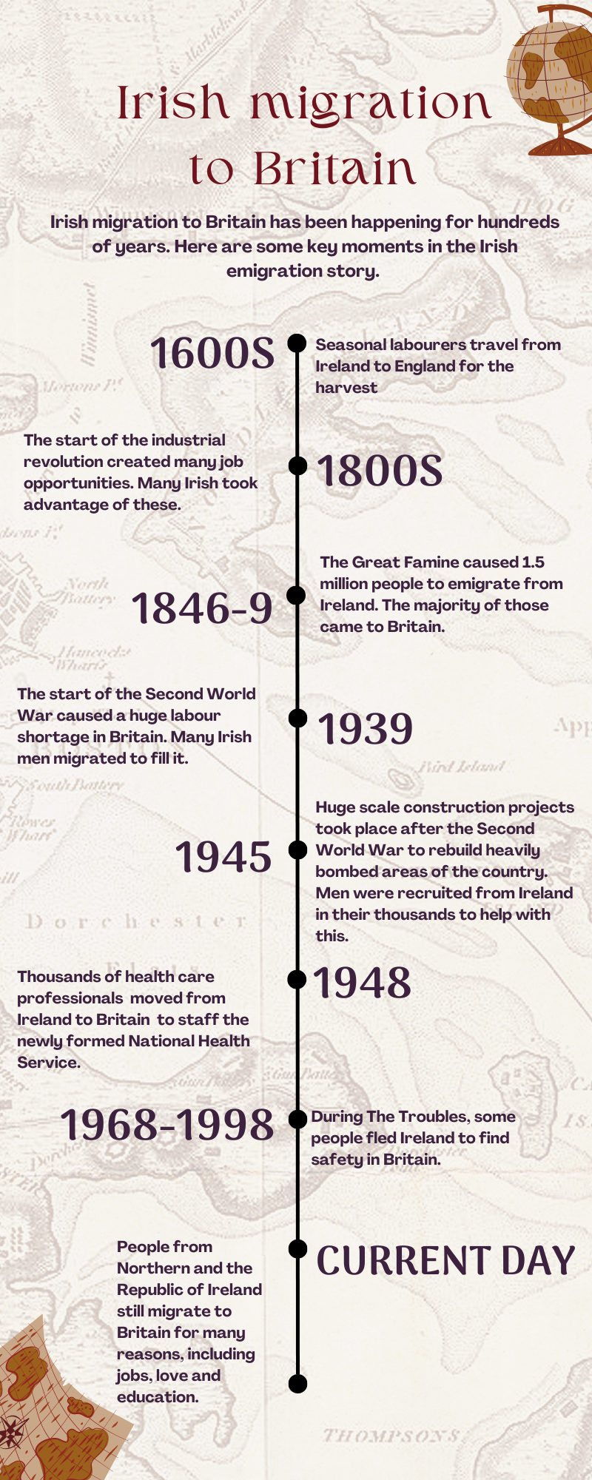
Case Study One:
Irish in London
Timeline

Slide 11
Case Study One:
Irish in London
Key locations in Camden
The London Irish Centre
The London Irish Centre has served the Irish community in London since it was first established in 1954 in Camden. The London Irish Centre was founded by the Irish Priests Committee who were worried about unprepared Irish emigrants arriving in London after World War II. The location was chosen because it was near to Euston station, where many Irish migrants would arrive. Initially the London Irish Centre provided accommodation and support to migrants, but soon it became an important social and cultural venue. The presence of this community hub shows the importance and size of the Irish community in Camden (and wider London).
Arlington House
Arlington House in Camden Town, opened in 1905, became the first port of call for many new arrivals from Ireland in the borough. Initially called Rowton House, it was the last of a group of hostels built in London by Victorian philanthropist Lord Rowton for working men. Many Irish immigrants struggled to find private accommodation on arrival, largely due to anti-Irish and anti-Catholic beliefs amongst landlords. Arlington House provided a safe space for them to stay. At its peak, Arlington House had a capacity for 1,200 people and was said to be “home to more Irish men than any other building outside Ireland.” Even into the 1990s, Irish men constituted almost half of the hostel’s population, and for many it became their permanent home.
Arlington House provided a home for many famous names. Author Brendan Behan lived there temporarily, as well as the poet Patrick Kavanagh. They were part of the significant number of Irish migrants that travelled to London after World War II, many of whom stayed at Arlington House when they first arrived in Britain. Many of these would take the train from Holyhead, which was the port of arrival for many Irish immigrants, into Euston station, so Arlington House was in a good location. Author George Orwell also stayed at Arlington House and he wrote about it in his book ‘Down and out in Paris and London’ saying:
‘The best [lodging houses] are the Rowton Houses, where the charge is a shilling, for which you get a cubicle to yourself, and the use of excellent bathrooms. You can also pay half a crown for a special, which is practically hotel accommodation. The Rowton Houses are splendid buildings, and the only objection to them is the strict discipline, with rules against cooking, card playing, etc’
Key Words
Philanthropist - A person who seeks to promote the welfare of others, especially by the generous donation of money to good causes
Notes:
Key Words
Philanthropist - A person who seeks to promote the welfare of others, especially by the generous donation of money to good causes

Slide 12
Case Study One:
Irish in London
Activity One
The poet Patrick Kavanagh, from Co. Monaghan, stayed in Arlington House in the 1930s and later wrote in his autobiography, The Green Fool:
"Many Irish boys made Rowton House, Camden Town, first stop from Mayo. The soft voices of Mayo and Galway sounding in that gaunt, impersonal place fell like warm rain on the arid patches of my imagination.”
Discuss in pairs what Patrick meant by that statement and what it might tell you about the experience of migrating.
Finish this sentence:
This quote from Patrick shows that migrating was a _____________ experience and that having connections to home was _________ because _______________________________________
To Patrick, the sound of people’s voices reminded him of home. Write a list or draw a collection of images of other things that might remind someone of home.
Activity Two
Watch the clip from the documentary* on Arlington House and answer the following questions at the end:
What did Arlington House provide for its residents?
Why were men migrating from Ireland to Britain?
Why did men want to live at Arlington House?
*Please note this primary source includes a swear word at 6:17 and between 10:48-11:02. We have included it in this pack as it is a rich primary source of information from people who lived in Arlington House, however it is at your discretion as to whether you allow your students to hear the swear word or not.

Slide 13
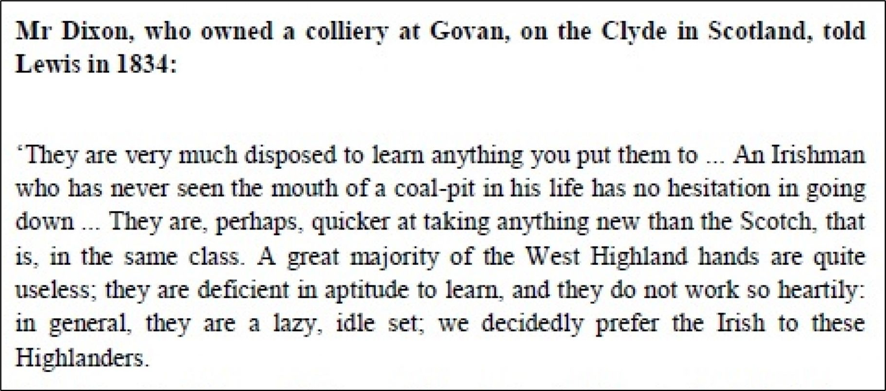
Case Study One:
Irish in London
Activity Three
The following sources are from George Cornewall Lewis’ 1836 survey of the Irish community in Britain and the effect of employing Irish workers. He travelled around Britain to different areas which had big Irish populations and recorded people’s opinions on Irish workers. Compare how the Irish migrant community is portrayed in each source:
Is each source a positive, negative or neutral view of Irish immigrants?
How are Irish immigrants described in each source?
Why do you think Irish immigrants might be described differently in these two sources?
Source A
Source B
Link to sources

Slide 14
Case Study One:
Irish in London
Resources
We have identified some more resources that you can use to delve deeper into the history of Britain and Ireland and Irish immigration.
Liverpool Mercury Soundbite on Irish Migration
Different attitudes to Irish in Britain 1750-1900 Liverpool Mercury Soundbite on Irish Migration
The Great Famine Activity Pack From EPIC
Short explanation of Irish Immigration (2:12 – 3:26)
Irish Born Census Data
Extended reading on Irish migration to Britain (for teachers)
Extended reading on the relationship between Ireland and Britain
Full interviews with Arlington House residents More information on the Troubles
Other part of the Arlington House documentary

Slide 15
Case Study Two:
Kenwood House & Dido Elizabeth Belle
Kenwood House is thought to have been built in the early 17th century. Between 1764-1779 it was transformed into a neoclassical villa for William Murray, 1st Earl of Mansfield. It is during this time that Dido Elizabeth Belle lived there.
Dido Elizabeth Belle (1761-1804) was the daughter of Royal Naval Officer Sir John Lindsay and a young Black woman named Maria Bell. Maria was enslaved when she met Sir John Lindsay although she was later freed. It is thought that John and Maria must have met while his ship was sailing around the coast of Senegal and the Caribbean in 1760. We do not know the exact date that Dido came to England or moved to Kenwood House, but she spent much of her life there under the guardianship of her great-uncle William Murray, 1st Earl of Mansfield.
Dido’s exact position at Kenwood House is unclear, but the evidence suggests she was brought up as a lady alongside her cousin Elizabeth Murray. She could read, write, play music, was comfortable in the company of guests and received an annual allowance. Dido also supervised Kenwood’s dairy and poultry yard, a common pastime for aristocratic women in the 18th century. As Dido was mixed-race, this was a very unusual situation. In Britain in the 18th century, being mixed race was relatively rare and many people of colour in Britain were servants or former enslaved people.
Dido’s great-uncle, Lord Mansfield, was Chief Justice (the most powerful judge in England) from 1756-1788. During this time he gave judgment on a number of court cases connected to the slave trade. The most famous of these was the case of James Somerset in 1772, where Lord Mansfield declared that slave owners were not allowed to send any enslaved people, or former enslaved people, in Britain to other countries. This is seen as a step towards the abolition of the slave trade. However, despite this, Lord Mansfield still strongly believed that the slave trade brought great economic advantages to Britain and was not fully committed to the abolition of slavery.
Dido lived at Kenwood House until her great-uncle died in 1793, when she married a steward called John Davinier, who was originally from France. They moved to Pimlico, where they had three sons. Although Dido had never been enslaved, her great-uncle made sure to protect her rights in his will by stating she was a free woman when he left her an allowance in his will.
Key Words
Enslaved- The act of making a person a slave, taking away their rights and freedoms and forcing them to work for no pay and obey commands
Poultry - Domestic birds, including chickens, turkeys, geese and ducks, raised for the production of meat or eggs
Aristocratic -A person of, or belonging to, or typical of the aristocracy. Which is the highest class in certain societies, typically comprising people of noble birth holding hereditary titles and offices
People of colour - A person who does not define themselves as white
Abolition - The act of removing a system, practice, or institution, often referring to the ending of the slave trade.
Steward - A person who is responsible for looking after someone else’s property

Slide 16
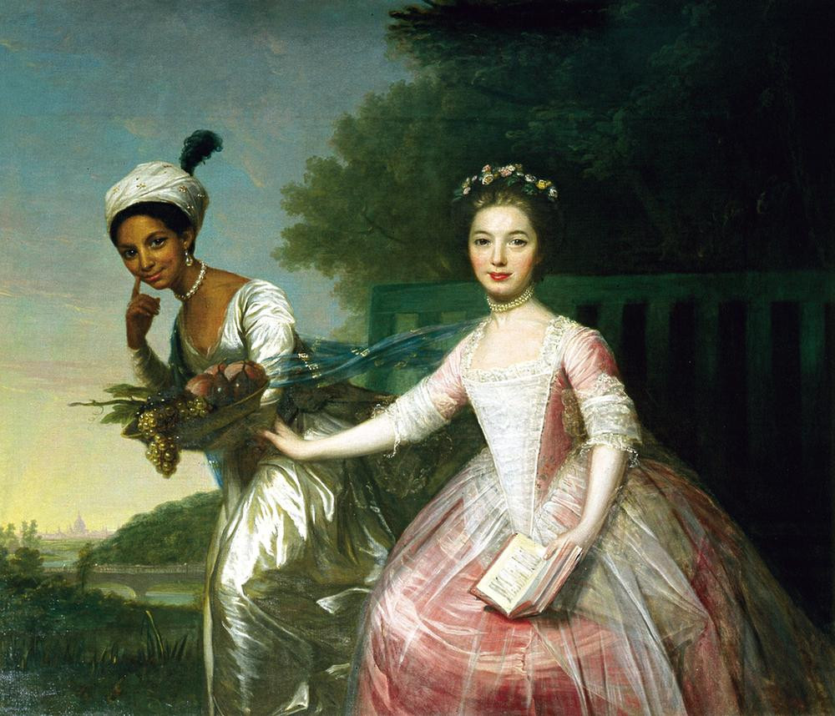
Case Study Two:
Kenwood House & Dido Elizabeth Belle
Activity One
This portrait was painted by Scottish artist David Martin. The painting is of Dido Belle and her cousin Elizabeth. Imagine you are describing this portrait to someone who hasn’t seen it before. In small groups write a description (two paragraphs) of this portrait.
While writing your description think about:
What can you see in the painting?
What does this portrait show you about the relationship between Dido and her cousin Elizabeth?
What does this painting tell you about Dido’s status?
Who do you think might have had this painting created?
Why do some people think this is an important piece of art?
You can use these sentence starters to help you:
The portrait shows that Dido and her cousin were _________________________________
We can see that Dido’s status is __________ because ______________________________
This is an important piece of art because at the time _______________________________
In this painting I can see Dido carrying ______________________and Elizabeth carrying _______________. I think this might be to show_________________________________
Painting of Dido Belle and her cousin Elizabeth Murray. Credit: Wikimedia Commons

Slide 17
Case Study Two:
Kenwood House & Dido Elizabeth Belle
Activity Two
Watch this clip from the movie ‘Belle’ about Dido Elizabeth Belle and read this summary of the Zong Case.
How do you think Dido would have felt learning about some of the slavery cases her great uncle judged, while she was the daughter of an enslaved woman? Put yourself in Dido’s shoes and write a letter to your mother Maria, discussing how you might have felt growing up in Kenwood House during a time of legal cases about the slave trade and the growing abolition movement.
Lord Mansfield was not an abolitionist. He thought that the slave trade brought many advantages to Britain. He believed in the trade benefits of slavery and its importance to the British economy. Despite this, he had a niece whose mother was formerly enslaved and sought to challenge individual instances of cruelty to enslaved people.
As a class discuss how you think it was possible for Lord Mansfield to have family members who were formerly enslaved, speak up for the rights of enslaved people in individual cases and still support the slave trade. Is it possible for a person to hold these conflicting views at the same time?
Activity Three
Note: The language in this extract reflects the language that was used in the 18th century. This language is now seen as unacceptable.
‘A Black came in after dinner and sat with the ladies and, after coffee, walked with the company in the gardens, one of the young ladies having her arm within the other […] He calls her Dido, which I suppose is all the name she has. He knows he has been reproached for showing fondness for her – I dare say not criminal.’
Thomas Hutchinson (ex-governor of Massachusettsts, USA), 1779.
Link to quote
In pairs, discuss this statement:
What do you think Thomas thinks of Dido from this statement?
How do you think Lord Mansfield might have responded to this comment?

Slide 18
Case Study Two:
Kenwood House & Dido Elizabeth Belle
Resources
We have identified some more resources that you can use to delve deeper into the history Dido Belle, Kenwood House and the transatlantic slave-trade.
Resources about Dido Elizabeth Belle
English Heritage podcast
English Heritage Biography
Short English Heritage video
Wikipedia
‘Unusual Portrait’ section to learn about Dido’s portrait
Primary Sources
Extended reading on Dido
Human Resources | Podcast on Britain and the slave trade
Other Resources
English Heritage History of Kenwood House
James Somerset Slavery Court Case
Summary of Slavery Cases Presided Over by Lord Mansfield
Mapping Black London - London Metropolitan Archives

Slide 19
Case Study Three:
Paul Verlaine and Arthur Rimbaud
Migration histories are not the only histories that are often lesser known; the same is true of LGBTQ+ histories. The history of 8 Royal College Street falls into both categories, as famous French poets Paul Verlaine and Arthur Rimbaud briefly lived there during their relationship.
The teenage poetry prodigy Arthur Rimbaud met the older, established poet Paul Verlaine in France in 1871. Despite Verlaine being married with a child, they started a relationship and moved to London not long afterwards. They arrived in London in September 1872 and lived at 34 Howland Street, Fitzrovia (this is now where the BT Tower is). In London they joined the growing migrant community of political refugees and religious dissenters from Europe who had found safety and entertainment in London. It is possible that while in London the pair crossed paths with Karl Marx, who had been exiled from France, either in the Reading Room at the British Library where they all liked to spend time, or while he gave talks around the city.
In 1873 Rimbaud and Verlaine moved into 8 Royal College Street in Camden Town, joining a borough where many immigrants (mainly Irish) lived. While there, in order to earn some money they offered Latin and French lessons: “Leçons de Français, en français – perfection, finesses – par deux Gentlemen Parisiens – Verlaine, 8, Great College Street, Camden Town.” While in this house, the 19 year old Rimbaud wrote two of his most famous works ‘Illuminations’ and ‘Une Saison en Enfer’.
However, their time in 8 Royal College Street lasted only 3 months. After a fight Verlaine left Rimbaud to go back to his wife in Brussels.
Both Verlaine and Rimbaud came back to London at different points in their lives, although never again together. Although Rimbaud stopped writing poetry at 20, he is remembered as a leading modernist poet who transformed French poetry. Verlaine is also recognised as one of the most important French poets of the 19th century and many of his poems were set to music by celebrated French composers in the 19th & 20th centuries. Both their lives and poems have also influenced a range of music and films, including inspiring Bob Dylan’s music and the film Total Eclipse which starred Leonardo DiCaprio. Another legacy of Verlaine is that lines of his poem ‘Chanson d’automne’ were used to inform the French Resistance of the timings of D-Day in 1945, so they could sabotage German operations in occupied France.
8 Royal College Street remains an important location to this day due to the short stay of the two French poets. The Rimbaud and Verlaine Foundation is an arts organisation and registered charity who hopes to develop 8 Royal College Street into a ‘poetry house’. The foundation uses inspiration from Rimbaud and Verlaine to encourage engagement with the arts, especially in education.
Key Words
Prodigy - A child / young person with exceptional qualities or abilities
Political refugee - A person who has fled from their home because of being persecuted because of their political beliefs
Religious dissenters -A person who does not agree with the official religious beliefs and / or practices of their country
Modernist -A literary figure who chooses to break with traditional ways of writing

Slide 20
Case Study Three:
Paul Verlaine and Arthur Rimbaud
Activity One
Research one of Paul Verlaine or Arthur Rimbaud’s poems. Read a section of the poem out to the class and share some information about what this poem is about.
Teacher Tip: You could print out a selection of their poems to do this activity in class or do this as homework. Here is a link to a collection of Arthur Rimbaud’s poetry and Paul Verlaine’s poetry.
Activity Two
Using the information given, draw a creative timeline of Arthur Rimbaud and Paul Verlaine’s case study. Include drawings and text for key moments and locations in their story.
For example, one stop on your creative timeline could be 34 Howland Street. What would you draw or write to show this?

Slide 21
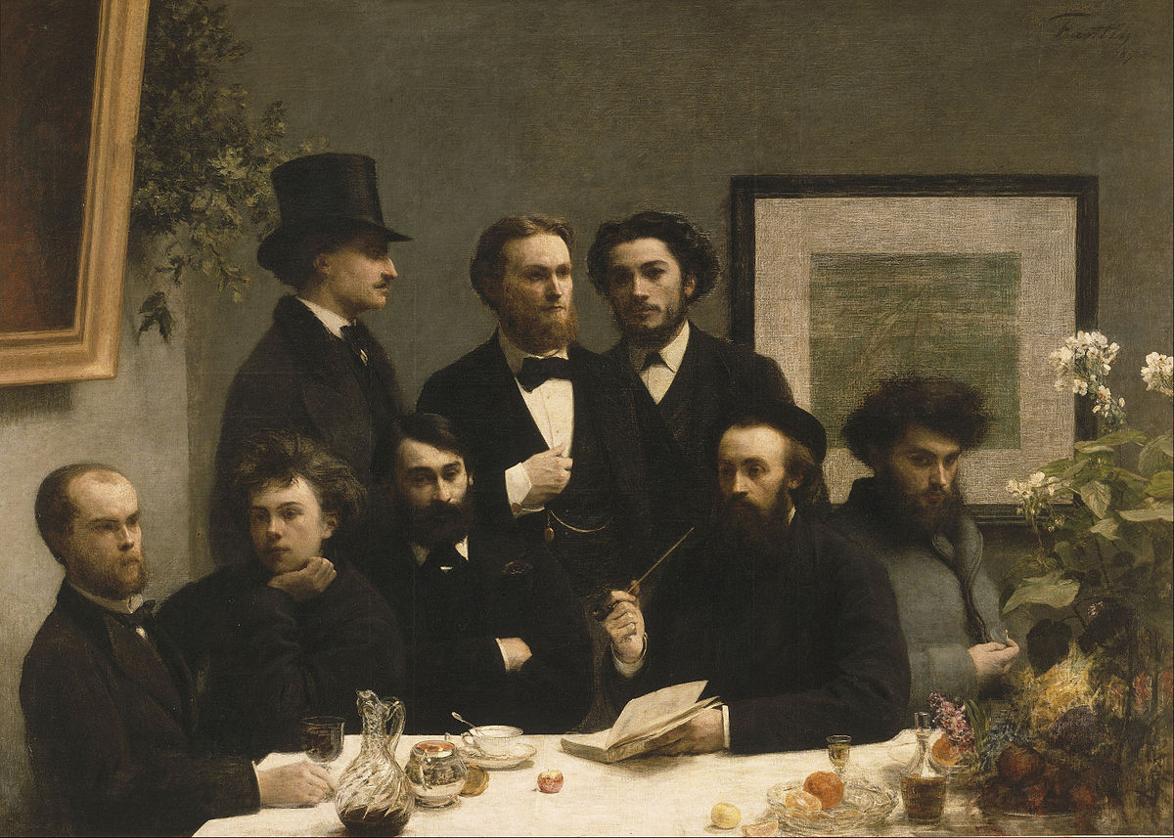
Case Study Three:
Paul Verlaine and Arthur Rimbaud
Activity Three
This painting ‘Un coin de table’ or ‘By the table’ is the third in a series of four group portraits done by Henri Fantin-Latour. The first two are of groups of painters he admired, the fourth is of musicians and this one is of famous people from the literary world. Paul Verlaine is the figure sitting at the table on the left hand side and Arthur Rimbaud is sitting next to him.
Analyse By The Table and answer the following questions:
What does it say about Verlaine & Rimbaud that they were chosen to be in this painting?
What do you think the painter is trying to say about Rimbaud and Verlaine in this painting?
Where do you think this painting takes place?
Who might the other people in this painting be?
X
‘Un coin de table’ by Henri Fantin-Latour, 1872
Copyright: Wikimedia

Slide 22
Case Study Three:
Paul Verlaine and Arthur Rimbaud
Resources
We have identified some more resources that you can use to delve deeper into the history of Arthur Rimbaud and Paul Verlaine
Biography of Arthur Rimbaud
Biography of Paul Verlaine
Short biographies of Rimbaud and Verlaine
Reasons for political refugees
Reading of Paul Verlaine’s poem ‘Street’ about London

Slide 23
Case Study Four:
Little Italy and St Peter’s Church
The Italian community has a strong presence in the borough of Camden. During the 19th century the Saffron Hill area – the area between Clerkenwell Road, Farringdon Road and Rosebery Avenue – gained a growing population of working-​​class Italians, mostly from southern Italy. This area is known as ‘Little Italy’ because of the presence of so many Italian migrants in the area. Northern Italian migrants, who mainly moved in the late 19th and early 20th century, created a community in Soho. The Italian consul published a report in 1895 estimating that there were 12,000 Italians in London.
By 1850 there were about 2000 Italian immigrants in ‘Little Italy’. Their jobs tended to be ones they could do while travelling, there were “organ men, ice vendors, ambulant merchants, plaster bust sellers, models for artists, etc.”. They had to go to Lincoln’s Inn Fields to find a Catholic Church to pray in as they didn’t have their own. In 1845, Saint Vincent Pallotti decided to build a church for Italian migrants in London. St Peter’s Italian Church was built in the centre of ‘Little Italy’ in 1863 for the growing Italian population in the area. It is modelled on the Basilica of San Crisogono in Rome and was the largest Catholic Church in Britain when it was built. It was consecrated as ‘The Church of all Nations’, reflecting its strong connections to migration. The architect, John Miller-Bryson who designed the church, was from Ireland and in the 1870s they had a number of Polish priests who worshipped in the Polish Chapel in the crypt.
The procession of Our Lady of Mount Carmel – held on the first Sunday that happens after the 16th July each year– is ‘Little Italy’s’ most important event and starts from St Peter’s Italian Church. It has taken place annually since 1896, apart from during the First and Second World Wars. Queen Victoria is said to have granted special permission to the local police chief in Holborn for the parade to take place. According to the historian of St Peter’s Italian Church, “it appears to have been the first outdoor Roman Catholic manifestation of faith [in England] since the time of Henry VIII’s Reformation.”
During the Second World War the church was taken out of Italian hands due to rising hostility and suspicion towards Britain’s Italian immigrants. On 10th June 1940 when Italy declared that it was joining the Axis powers, all 20,000 Italian residents were now classified as ‘enemy aliens’ and were seen as potential enemy spies. Any man between the ages of 16-70 who had lived in Britain for less than 20 years was considered for internment. Many of those living in London and the South East were interned immediately. This was despite many of these people having lived in Britain for decades, with jobs, families and communities. Others were people who had escaped Europe and arrived in Britain as refugees.
Key Words
Consul - An official appointed by a state to live in a foreign city and protect the state's citizens and interests there
Consecrated - When a religious building or piece of land is made sacred
Architect -A person who is qualified to design buildings and to plan and supervise their construction
Crypt - An underground room in a church which is used as a chapel or a burial ground
Manifestation - An event, action or object that shows something abstract or theoretical
Refugee - A person who has fled their country due to well-founded fear of persecution for political, religious or ethnic reasons, or because of war, and been granted status to remain in a new country for their safety

Slide 24
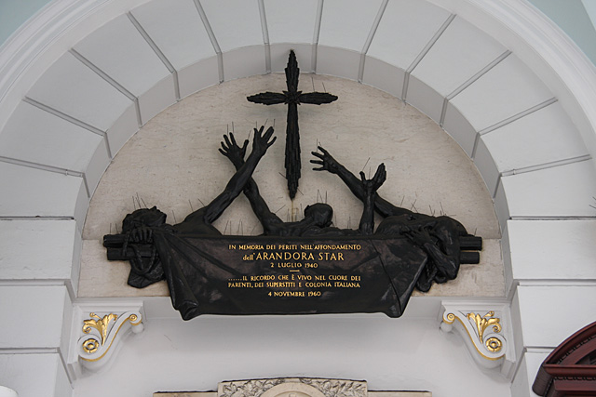
Case Study Four:
Little Italy and St Peter’s Church
Continued…
Over the course of the war, up to 30,000 people (many were German and Austrian) were arrested and placed into internment camps across Britain, most of these people were men but as many as 4,000 were women and children. 4000 of these were Italian men. There were internment camps across Britain; the largest was on the Isle of Man but there were also ones in Glasgow, Liverpool, Manchester and London to name a few places. Some of the people interned were even then deported to camps in Canada and Australia.
On 2nd July 1940 the SS Arandora Star was carrying prisoners from Liverpool to Canada, when it was mistakenly sunk by a German U-boat resulting in a large loss of life. On board were 734 Italians, 438 Germans (including both Nazi sympathisers and Jewish refugees) and 374 British seaman and soldiers. Over half the people on board died, including 470 Italians. A plaque commemorating those lost can be found next to the front door of St Peter's Italian Church. It was this event which swayed public sympathy towards ‘enemy aliens’. By October 1940, 5,000 German, Austrian and Italians had been released from internment camps.
Image of Remembrance for the drowned plaque, St Peter’s Italian Church, 2008
Copyright: Wikimedia Commons
Key Words
Refugee - A person who has fled their country due to well-founded fear of persecution for political, religious or ethnic reasons, or because of war, and been granted status to remain in a new country for their safety
Internment camps - A prison camp for civilian citizens, especially those with ties to an enemy during wartime

Slide 25
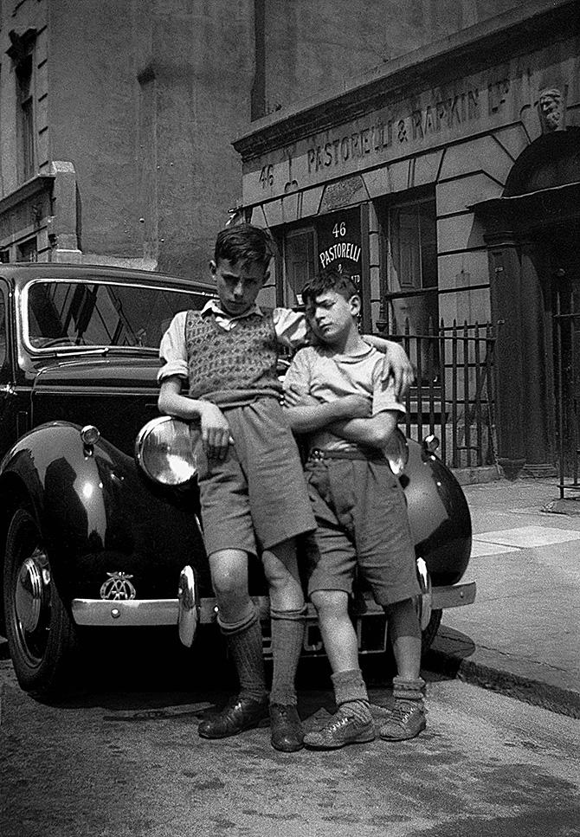
Case Study Four:
Little Italy and St Peter’s Church
Activity One
Here are two images taken at different periods of time but both in the Clerkenwell area of London. Examine the images, what is happening in each of the photographs? What do they tell you about this area of London in the 1940s and 2000s? How might you use these images to discuss the changes that this area has undergone?
The first image was taken in 1949 by Colin O’Brien of his two Italian friends in Hatton Garden.

Slide 26
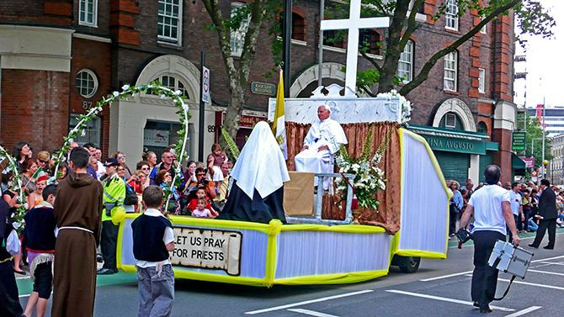
Case Study Four:
Little Italy and St Peter’s Church
Activity One
The second image was taken by Alan Denny of an Italian procession in Clerkenwell in 2007.
Additional Enquiry:
The photographer Alan Denny who took this picture also wrote the statement below. Read through this statement and have a think about why it is so important for different communities to keep their culture alive through processions, holidays, carnivals and parades.
“When you move to a new country everything is different, you’re surrounded by people who don’t look like you and don’t think like you. You can’t tell who will help you, who will ignore you and who might be hostile. You wonder if leaving home was a mistake. Sometimes you’re not sure who you are, would your parents recognise you? It feels like you are on your own. For some people, practising the religion of their parents together with other uprooted people is a way of giving and getting support. The Italian procession with its floats of saints and biblical tableaux gives the community a chance to proudly show off its Italian roots.
Even though I am anti-clerical, atheist and only 50% Italian, I still love the Procession for its wall-to-wall Italians, porchetta, focaccia, watermelon and Peroni: it feels good to be out on the street with so many italians.”

Slide 27
Case Study Four:
Little Italy and St Peter’s Church
Activity Two
Many migrants keep their culture alive through cooking and eating food traditionally made in their countries. Do some research on some traditional Italian foods and design a sign advertising the food you are selling at your stall at the procession of Our Lady of Mount Carmel.
Activity Three
This activity can be printed or can be done on a computer. The section starts from ‘In 1940, 26-year-old Frank Berni…’ and ends ‘remaining in England until his death in 2000 at the age of 96.’
Read the case of Mr Frank Berni and look carefully at all of the sources relating to his case: https://blog.nationalarchives.gov.uk/internment-of-enemy-aliens-in-1940-the-fate-of-italians-resident-in-a-britain-at-war/
Imagine you are the judge on his case and write a statement detailing why he should be released from prison. Make sure you use evidence from his case to explain why he should no longer be interned.
Resources
We have identified some more resources that you can use to delve deeper into the history of internment of Italian migrants during WWII:
National Archives: Internment of Enemy Aliens in 1940
The Guardian: When Britain imprisoned refugees
BBC: WW2 Peoples War Fact File

Slide 28
Conclusion to Part One
We hope you have found this resource pack helpful for exploring the topic of migration with your students. Through the study of personal stories we encourage students to make the link between individual stories and the impact they have on the places and cultures around them. We encourage you to use these case studies as a starting point to delve deeper into the rich migration histories in your local area.
We have also created a Migration Story Disc template and resource, which is a great way to introduce the topic of migration and collect stories from your school and community. We encourage you to explore the Migration Museum’s Resource Bank for more migration themed learning resources. If you are interested in booking a visit to the Migration Museum, an in-school workshop or assembly or a walking tour, please get in touch via info@migrationmuseum.org
Thank you to Open City and many others, who provided advice in the development of these resources. If you have any questions or feedback, please contact our Senior Learning Manager Liberty: Liberty@migrationmuseum.org

Slide 29
Part Two
Open City
Introduction
The next part of this pack works for older students - Key Stage 4 and 5 - as well as teachers wanting to go deeper into the wider context of the borough. It explores the intersections of geography, sociology, politics, and history. It grows out of the Open City project’s research into what it means to move into and make a home in the city, and to what extent cities, especially London, welcome newcomers.
The section explores race, ethnicity, migration, social housing, and education. It first focuses on some of the challenges in how race, ethnicity, and migration are linked and understood through official tallies and numeric data collection in the UK. It then focuses on the intersection of race and migration with social housing, discussing how national, London-wide, and local Camden housing policies have shaped how much or how little the city is a welcoming environment for new arrivals. Last, the pack looks at a history of activism dedicated to addressing racist discrimination in Camden education.
This part question how migration histories are recorded, whose histories are recorded, and who chooses which histories students are taught. It may also be a useful secondary resource for teachers to put the case studies in part one into the broader sociological and political context of Camden migration.
We would love to hear any feedback or questions you may have, and would also welcome insights on how students respond and react to the information provided in this pack. Please don’t hesitate to be in touch with the Open City project Research Fellows Susannah and Eda at Susannah.Cramer-Greenbaum@warwick.ac.uk and Eda.Yazici@warwick.ac.uk.

Slide 30
Open City
Understanding race, ethnicity and migration
How do people, communities and institutions understand race, ethnicity and migration? If someone asked you about your race, or ethnicity how would you answer? If you’ve ever seen an official form, you may have noticed that they often ask about your ethnic group. However, not everyone may feel represented or reflected in the list of options. The way that information is collected about people's race or ethnicity can tell us a lot about attitudes towards migration.
On the one hand information collected about people’s ethnic or racial identity can help organisations like the local council to see how diverse a local area is or even understand levels of discrimination. On the other hand, some think that asking people to share personal information like race or ethnicity helps to create and maintain differences and divisions between people.
Race is a set of ideas that is used to group people or identify differences between people, often based on visible differences. The idea of race has been used to describe some groups of people inferior or superior to others. The idea of race is a social construct that emerged as a way to justify things like enslavement, colonial oppression, and genocide.
Ethnicity is more often linked to a national background or even a specific minority within a national group such as “white English” or “white Scottish”. Both terms are difficult to define and there is much debate over what the terms mean and how they are used.
Key Words
Social construct- The meaning placed on an object or event by a society
Enslavement - The act of making a person a slave, taking away their rights and freedoms and forcing them to work for no pay and obey commands
Colonial oppression - Prolonged cruel and unjust treatment by colonial powers or structures.
Genocide - A prison camp for civilian citizens, especially those with ties to an enemy during wartime

Slide 31
Open City
Understanding race, ethnicity and migration
Discussion
The census is a national survey that happens every 10 years. It gives a picture of all the people and households in England and Wales. Answers to census questions help organisations make decisions on planning and funding public services in an area. It can also help measure changes in a local area.
The 2021 census used the following categories to ask about people about their ethnic group:
Asian or Asian British
Indian
Pakistani
Bangladeshi
Chinese
Any other Asian background
Black, Black British, Caribbean or African
Caribbean
African
Any other Black, Black British, or Caribbean background
Mixed or multiple ethnic groups
White and Black Caribbean
White and Black African
White and Asian
Any other Mixed or multiple ethnic background
White
English, Welsh, Scottish, Northern Irish or British
Irish
Gypsy or Irish Traveller
Roma
Any other White background
Other ethnic group
Arab
Any other ethnic group
How such categories are used have changed over time. In 1978, surveys conducted by Camden Council and the Greater London Council asked about “father’s birth place” giving the following options to choose from:
Great Britain
Ireland (North and South)
Rest of Europe (including Cyprus and Malta)
Caribbean (West Indies)
Asia (India, Pakistan, Bangladesh, China)
Africa
Other
No response/withheld
In groups consider the questions below:
Compare the current categories to the categories from 1978. How have they changed? Write down three changes. Discuss in pairs why you think these changes have taken place
Do you see yourself represented in the two sets of categories from 1978 and 2021? Write down why you think that some groups are represented and not others.
How do you think we should ask about race, or ethnicity if at all?

Slide 32
Open City
Race, migration & social housing in Camden
Social housing is usually owned by local councils or by housing associations. They provide affordable rent because rents are tied to local incomes. Social housing is secure because it is long-term. Some of the social housing estates in Camden are very famous. People from all over the world come to see the architecture of Camden’s social housing estates.
Many people want to live, work, and study in Camden because of its central London location, many parks, services and resources. Camden is also an important transport hub. This means that for many people Camden is the first borough they see when they arrive in London.
In the 1950s and 1960s, it was very difficult for new migrants in London to access social housing. Many people lived in substandard, and over-crowded conditions often with whole families renting a single room in a shared house. When new migrants were able to access social housing, it was often given in the poorest parts of London and in older social housing estates rather than the brand new ones that were being built at the time. By 1975, it was clear that white-British people were more likely to be given brand new social housing with gardens in New Towns and on the outskirts of the city with migrants and people of colour being given smaller flats in inner city areas like Camden.
In 1978 Camden Council committed to providing housing to all new migrants arriving at Euston and Kings Cross Stations. Camden Council and the Greater London Council (which was abolished in 1986) provided housing to lots of new arrivals including refugees from Chile, Uganda, Cyprus and Vietnam. Even though Camden Council began to try to welcome migrants and people of colour, there were lots of racist reactions to this by other residents in the borough.
Key Words
Abolished- To formally put an end to something; a system, practise or institution

Slide 33
Open City
Race, migration & social housing in Camden
However, in 1999, new legislation made it very difficult for local councils to provide housing to people seeking asylum and new refugees. Since 1999, new arrivals seeking refuge in Britain have been ‘sent’ to other parts of the country, making it difficult to stay in touch with friends or family in London.
Today, there is far less social housing available than there was in 1980. There are 1 million people in England on the waiting list for social housing. Last year, 29,000 social houses were sold or demolished and less than 7,000 were built This means that in recent years, especially in London, many families are once again living in overcrowded and sub-standard conditions. Many people have unaffordable rents.
Discussion
Discuss the following questions, either in small groups or as a class:
How do we make cities more welcoming?
What role does housing play in making cities more welcoming?
How should limited resources be allocated?
How would you feel if you were given no choice in where you lived?

Slide 34
Open City
Race, migration & social housing in Camden
Housing Estate Structures
Social housing estates also have their own distinct histories. Who our homes are named after and who used to own the land that they are built on can tell us a lot about race, migration and the struggle for safe, secure housing for all.
Discussion
Read the histories of Hilgrove, Chalcots, and Alexandra Road Estates in North Camden. In small groups discuss:
Did anything about the histories of the estates surprise you?
Who gets to decide what our homes and cities look like?
Do you know of any other buildings or places in Camden that have a connection to colonialism, rich landowners, or slavery?
Read pages 3-18 of the pocket publication, in pairs discuss:
Did anything surprise you?
What are the similarities to where you live?
What are the differences to where you live?
What you know about the history of where you live?
Teacher’s note: it is possible to do the Estate Anatomies guided walk which begins in Primrose Hill and ends in South Hampstead. You may also consider encouraging your class to conduct similar research on a local estate with additional support from the Open City team. Contact opencity@warwick.ac.uk for more information.

Slide 35
Open City
Race, migration and education in Camden
Camden is famous for having many world renowned universities. Its central location also means that it is often a place where different activist groups meet and work towards changing society.
In the 1970s, anti-racist teachers formed the ‘Camden anti-racist teachers’ group and ran workshops. They wanted to decolonise the curriculum and take racist stereotypes out of school textbooks. They organised events such as ‘African History: what do we teach’ in 1977, which looked at racist stereotypes about Africa in textbooks and how to change them.
Parents were also very active in resisting racist exclusion and discrimination in schools. In the 1960s, 1970s, and 1980s, many children from racialised minorities, often young people of colour or new migrants, were expelled or deemed to be ‘educationally subnormal’ by racist educators and sent to ‘special schools’.
In addition, some Educational Authorities who thought there were too many migrant children, started sending children as young as five very far away from their home areas to be educated. The aim was to ‘integrate’ migrant children by forcing them to go to majority white schools. Sometimes this would mean that children would have to travel many hours to travel to schools where they would experience racism or discrimination. Educational Authorities wanted to limit the number of ‘migrant’ children to no more than 30%. Many parents, carers and young people resisted these exclusions. For example, the Black Parents Movement, the Caribbean Parents Group and the National Association of Supplementary Schools fought hard to end bussing, and exclusion from schools.
Parents and carers got together to organise alternative Saturday Schools to teach Black History and to provide classes to children and young people who had been unfairly excluded or sent to ‘special schools’ for no reason. The Black Parents’ Movement slogan was ‘we are our own educators’. This slogan showed how little inclusivity there was in schools at the time. In Camden, the Winnie Mandela School was set up. This school was a supplementary school run by the Camden Black Parents and Teachers Group, which aimed to provide additional support to children in Camden.
Key Words
Decolonise - free an institution or system, e.g. the education system, from the cultural and social effects of colonisation
Stereotype - a widely held but fixed and oversimplified image or idea of a particular type of person or thing
Exclusion - When you are not allowed to be in school
Discrimination - the unjust treatment of different categories of people, especially on the grounds of ethnicity, age, sex, or disability

Slide 36
Open City
Race, migration and education in Camden
Discussion
In groups discuss:
Why are some things taught in school and not others?
Who has the power to decide what we learn in schools?
Do you think all children should learn the same things at school?
If you ran your own school, what would you teach?
Resources
Small Axe: Education
Concluding discussion
As a class discuss:
Which groups or communities do you think are missing from this resource pack?
Do you feel your own histories were represented here?
Depending on which groups you think are missing, start collecting stories or doing research into stories that you could add to this resource pack. Here are some ideas of how you could do this either in the classroom or at home:
Speak to your parents or grandparents about their stories of arriving and settling in Camden.
Take photos of places that represent the diversity of Camden. This could include shops, cafes, religious buildings or other businesses.
Use the Migration Museum story disc activity to record your story.
Use Camden Local Studies archive and resources online to find out more about Camden’s diverse communities.
Use the Migration Museum family tree activity to discover your own family history
Next steps
This resource pack has information about a handful of Camden’s different migrant groups, but there are many more migration histories to uncover. These stories need to be heard and shared for us to understand where we live, the communities around us and who we all are.

Slide 37
Key Words and Definitions
Word | Definition
Abolish | To formally put an end to something; a system, practise or institution
Abolition | The act of removing a system, practice, or institution, often referring to the ending of the slave trade.
Absentee Landowner | Someone who legally owns the land without actually occupying it or managing it
Anticolonial | The opposition or objection of colonial rule of one country by another, opposing or resisting colonialism
Architect | A person who is qualified to design buildings and to plan and supervise their construction
Aristocratic | A person of, or belonging to, or typical of the aristocracy. Which is the highest class in certain societies, typically comprising people of noble birth holding hereditary titles and offices
Army Conscription | The compulsory enrollment of persons especially for military service
Asylum Seeker | A person who has fled their country due to well-founded fear of persecution for political, religious or ethnic reasons, or because of war, and is looking for a country and government to grant them protection and allow them to live there.
Catholic | A member of the Catholic Church, a type of Christianism that originates from Rome and the Vatican
Census | An official count or survey, usually of the population
Colonial | The policy and practice of a power (usually a country) extending control over other people or areas
Colonial Oppression
Conflict | A conflict is a struggle or clash between persons or groups, that can result in violence and war
Consecrated | When a religious building or piece of land is made sacred
Consul | An official appointed by a state to live in a foreign country and protect the state’s citizens and interests there
Crypt | An underground room in a church which is used as a chapel or burial ground
Decolonise | Free an institution or system e.g. the education system, from the cultural and social effects of colonisation
Discrimination | The unjust treatment of different categories of people, especially on the grounds of ethnicity, age, sex, or disability

Slide 38
Key Words and Definitions
Word | Definition
Displace | A person forced to leave their home, typically because of war, persecution, or natural disaster. You can be displaced within your country of origin
Emigrate | The action of moving away from a country
Enslaved | The act of making a person a slave, taking away their rights and freedoms and forcing them to work for no pay and obey commands
Exclusion | When you are not allowed to be in school
Genocide | The deliberate killing of a large number of people from a particular nation or ethnic group with the aim of destroying that nation or group
Guardianship | Being legally responsible for looking after someone, usually a child
Illegitimate | A child born to parents who are not legally married to each other
Immigrate | The action of moving into a country
Internment camps | A prison camp for civilian citizens, especially those with ties to an enemy during wartime
Labourer | A person doing manual work e.g. farm work
Manifestation | An event, action or object that shows something abstract or theoretical
Migrant | A person who has moved from one place to another
Modernist | A literary figure who choses to break with traditional ways of writing
Neoclassical | Literature, music, art or architecture that is inspired by the art and culture of classical antiquity
Partition | The action or state of dividing or being divided into parts, in this instance referring to the separation of Ireland. The partition of Ireland was the process by which the Government of the United Kingdom of Great Britain and Ireland, divided Ireland into two self-governing polities - Northern Ireland and Southern Ireland, enacted in 1921 by the Government of Ireland Act of 1920. Later the Republic of Ireland Act in 1948 declared the state of Southern Ireland as a Republic.
Person of Colour | A person who does not define themselves as white

Slide 39
Key Words and Definitions
Word | Definition
Philanthropist | A person who seeks to promote the welfare of others, especially by the donation of money to good causes
Political refugee | A person who has fled from their home because of being persecuted because of their political beliefs
Poultry | Domestic birds, including chickens, turkeys, geese and ducks, raised for the production of meat or eggs
Prodigy | A child / young person with exceptional qualities or abilities
Protestant | A member or follower of any of the Western Christian Churches that are separate from the Roman Catholic Church in accordance with the principles of the Reformation, including the Baptist, Presbyterian, and Lutheran Churches
Refugee | A person who has fled their country due to well-founded fear of persecution for political, religious or ethnic reasons, or because of war, and been granted status to remain in a new country for their safety
Religious dissenter | A person who does not agree with the official religious beliefs and / or practices of their country
Settler | A person who moves with a group of others to live in a new country or area. Could also be referred to as an immigrant, but has connotations with empire and colonisation
Slums | A dirty and overcrowded area inhabited by very poor people
Social Construct | The meaning placed on an object or event by a society
Social housing | Housing provided for people on low incomes or with particular needs by government agencies or non-profit organisations
Stereotype | A standardised mental picture or belief, that is held in common by members of a group and that represents an oversimplified opinion, prejudiced attitude, or uncritical judgement of a person or group of people
Steward | A person who is responsible for looking after someone else’s property
Tenant farmer | A person who farms rented land

