Slide 1
Notes:
A Migration Museum Project scheme of work

Slide 2
Background
The Migration Museum Project and teachers have collaborated to create this unit about the history of migration.
The Migration Museum Project is establishing a major museum of migration for the UK.
We believe it is important that every pupil should have the opportunity to learn about migration. What do you think?
Migration is a HUGE topic. Some people study it for a whole degree at university! We are going to be examining a number of important themes so you can start to understand more about the long history of migration to the UK.
*See British Future report for further reading: http://www.britishfuture.org/publication/talk-immigration/
ALL OUR STORIES
Notes:
An introduction for you and your pupils

Slide 3
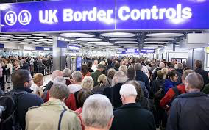
Introduction lesson
Watch
https://www.youtube.com/watch?v=lOZmqIwqur4
Notes:
This 8 minute video on YouTube sets out the basics about international migration. It helps set the context for the unit. You may want to have a brief discussion about it, or ask your pupils some questions about what they have seen.

Slide 4
Aim: To consider why and how we study migration
I will grasp what this unit will cover and have begun to make connections between the concepts, myself and others
I will begin to apply some of the key concepts to myself
I will understand that we are studying a unit on migration
Notes:
We have chosen to lay out the Lesson Objective in this differentiated way each lesson. Feel free to edit to fit with your school system.

Slide 5
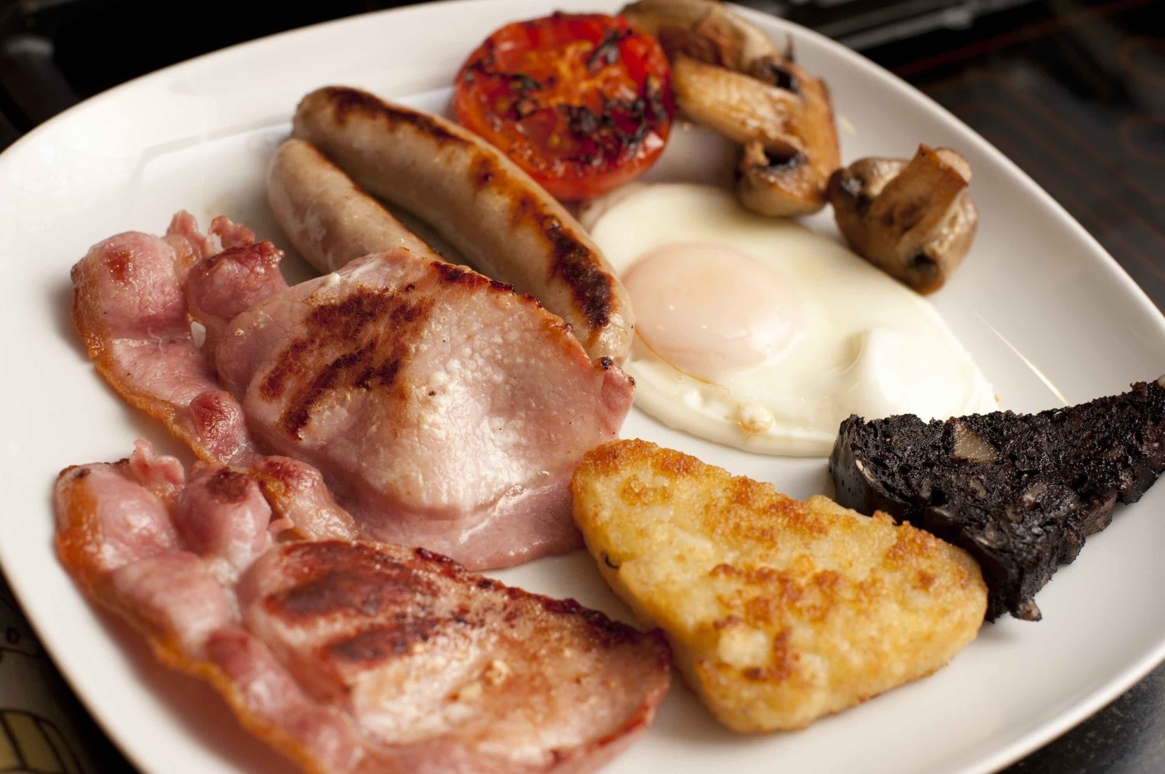
Watch: A British national breakfast
This is a spoken word piece by Hollie McNish.
As you listen, write notes on the following:
Name three things she mentions we might think of as British that come from abroad.
What do you think of the attitudes of the couple featured in the poem?
Why do you think we watch this at the start of this unit?
What is your own opinion?
Freeimages.co.uk
Notes:
Another short video to spark discussion. Use the questions we have provided, or your own.

Slide 6
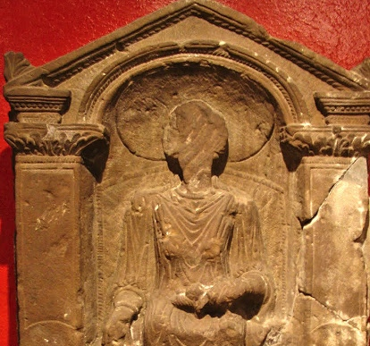
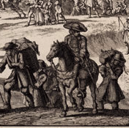
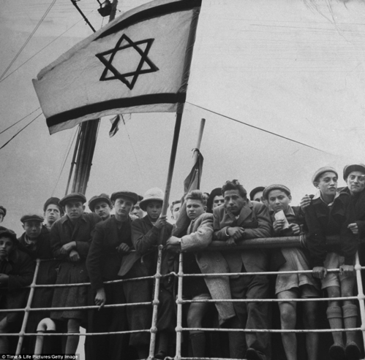
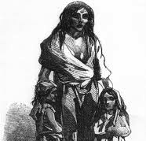
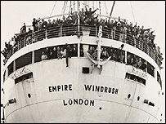
Unpacked to stay
When did Britain become a home?
Six immigration stories
Notes:
This lays out the lessons for the unit. Each circle contains an image to illustrate the theme for that lesson.
Lesson/circle 1 = Introduction
Lesson 2 = Roman Britain
Lesson 3 = The Huguenots
Lesson 4 = Jewish immigration
Lesson 5 = The Irish diaspora
Lesson 6 = Commonwealth immigration
Lesson 7 = Current migration debates

Slide 7
What’s this unit about?
Each lesson of the unit aims to tell the stories of different groups of immigrants to the UK from as early as 1070 right up to today.
The enquiry aims to examine Britain’s relationship with different people who have for different reasons made Britain their home.
It also aims to help us be more informed about immigration as we look at the world around us, and help us have a safe space to talk about our opinions and ideas.

Slide 8
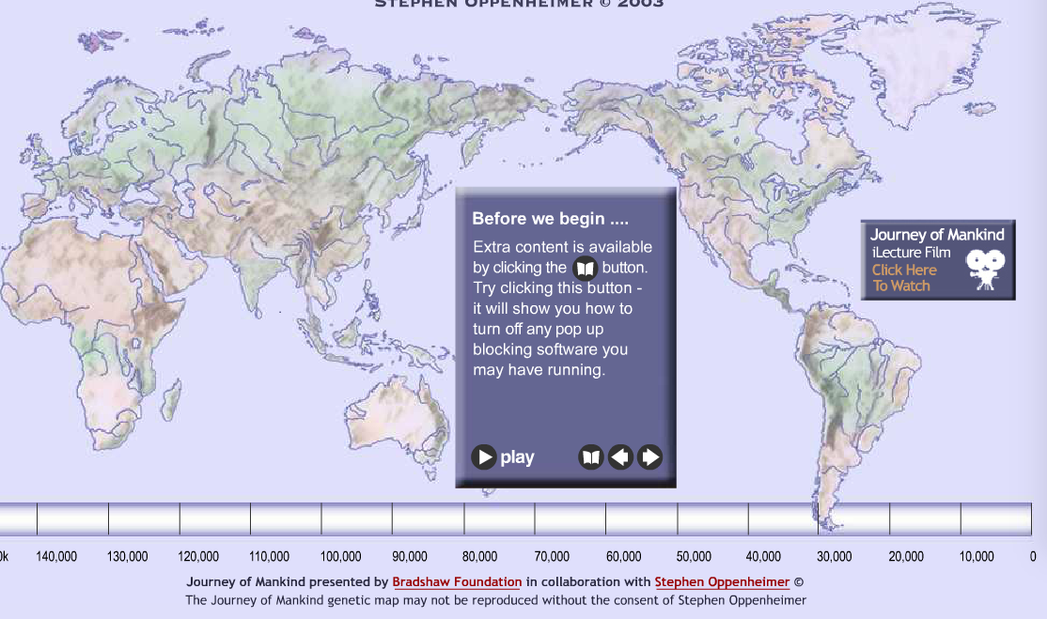
Migration isn’t new
Watch
http://www.bradshawfoundation.com/journey/
Notes:
Click through this interactive timeline of the origins of humanity and early migrations. The timeline is broken into sections, you might like to look at some in detail, depending on time.

Slide 9
In 1996, the Commission for Racial Equality stated that “everyone who lives in Britain today is either an immigrant or a descendant of an immigrant”. Not everyone is happy to agree with that statement. However, you don’t have to go back too far in human history to reach the time when the population of Britain was zero!
Think – Pair – Share
What do you think of this quote?
Notes:
This quote can be seen to link back to the beginning of the international migration video on slide 3 where the origins of human migration are laid out, and also to the interactive timeline just explored at slide 8.

Slide 10
Task: Ground rules
In your opinion, what are ground rules?
Why do we need ground rules for this unit?
What is important to you when discussing a potentially sensitive subject?
Task
In small groups discuss your top three rules
We will take each group’s rules and compile a set for the class
We will stick to these during the unit
Notes:
Many teachers choose to corporately design a set of ground rules for a unit like this that some pupils might find controversial or sensitive. You should also feed into the process any ground rules that you think are vital. Be sure to have this up in your classroom throughout the unit and be ready to remind pupils if needed. For more information on dealing with controversial issues see the advice on the MMP website: http://migrationmuseum.org/advice-for-teachers/

Slide 11
Migration Unit: Our ground rules rules
Note here your group’s ground rules for the enquiry.
Signed by:
Notes:
The template for the Ground Rules

Slide 12
Task: Personal connections with migration
Create a spider diagram with ‘Migration and Me’ in the centre. What connections do you have with migration? Think about:
Yourself
Family (parents, grandparents)
Aunts, uncles, cousins
Friends
Community and school
Religion
Food and drink
Entertainment (games, TV, sport, movies)
Migration and Me
Extra: what do you think are the most important aspects of migration in YOUR life?
Notes:
To explore pupils’ personal connections with migration you might choose this task or you might choose the Line Out activity that has been a success in MMP workshops. See the worksheet for short instructions for this Line Out activity.

Slide 13
Key words
Migration: people moving from one place to another
Multicultural: A society containing several different cultural or ethnic groups
Notes:
Gradually the keywords for this unit will increase in number. You might choose to put all keywords and definitions on the wall during the unit.

Slide 14
Plenary: Today I learned (TIL)
On a Post-it, write down one interesting thing you learnt today about migration.
Stick them up and discuss them.
Notes:
Use this or a different evaluation style plenary of your choice.

