Slide 1

Notes:
A Migration Museum Project scheme of work

Slide 2
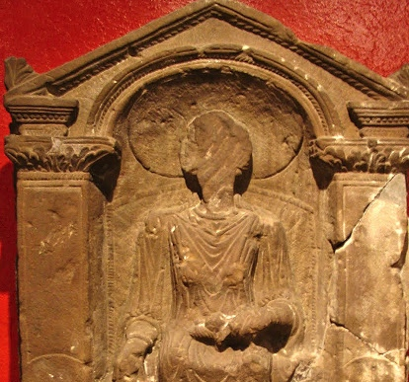
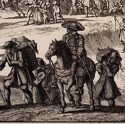
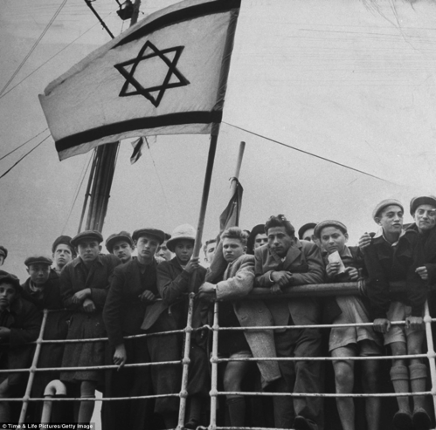
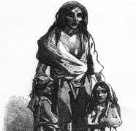
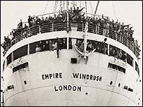

Unpacked to stay
When did Britain become a home?
Six immigration stories
Notes:
This lays out the lessons for the unit. Each circle contains an image to illustrate the theme for that lesson.
Lesson 1= introduction
Lesson 2 (circle 1) = Roman Britain
Lesson 3 = The Huguenots
Lesson 4 = Jewish immigration
Lesson 5 = The Irish diaspora
Lesson 6 = Commonwealth immigration - Windrush
Lesson 7 = Current migration debates

Slide 3
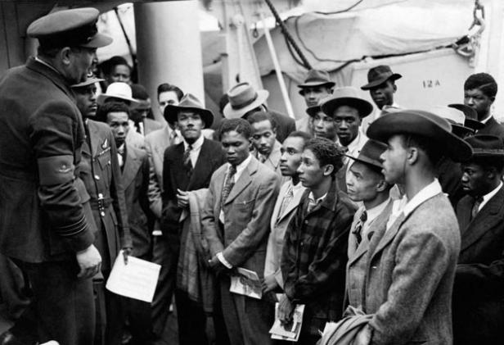
Unpacked to stay
When did Britain become a home?
Enquiry question:
What did the Windrush bring to Britain?
Notes:
This is the enquiry question for the lesson. Differentiated aims on next slide.

Slide 4
Aim: To begin to understand that the British Empire and Commonwealth have had an important impact on British migration
I will be able to prove, with examples, that Britain’s relations with its former colonies have affected diversity in Britain then and now
I will be able to show that the British Empire and Commonwealth have affected British immigration
I will be able to explain that some people moved to Britain from the former colonies
Notes:
We have chosen to lay out the Lesson Objective in this differentiated way each lesson. Feel free to edit to fit with your school system.

Slide 5
Key words
Migration: people moving from one place to another
Emigration: The act of leaving one country and going to live in another country
Empire: When one country rules over other countries (e.g the British Empire)
Colonies: In this context colonies refers to countries, regions and islands (such as India and parts of the ‘West Indies’) that were part of the British Empire and controlled from Great Britain.
Notes:
Gradually the keywords for this unit will increase in number. You might choose to put all keywords and definitions on the wall during the unit.

Slide 6
Task 1: Do now – Bingo. Choose 3 words
Elizabeth 1 | soldiers | Tudor
Cardiff | passport | post-war recovery
racism | National Health Service | transport

Slide 7
Task 1: Bingo – gap fill
On your sheet you will find sentences with words missing
The missing words are from your bingo grid
Can you fill in the sentences correctly?
Elizabeth 1 | soldiers | Tudor
Cardiff | passport | post-war recovery
racism | National Health Service | transport
Star student: Create 3 of your own gap-fill sentences for the words in the bingo grid
Notes:
The worksheet for this can be found at end of this powerpoint

Slide 8
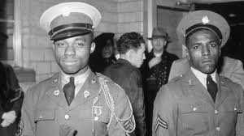
Task 2: Background information
As soon as the Second World War was over in 1945, politicians began to speak about Britain’s fight against the racist Nazi government. They said that Britain was a place where people of different ethnic backgrounds could live and work together.
Many Commonwealth citizens had fought for Britain during the war and many had lost their lives. They had shown how important they were to the British Empire.
Notes:
Thanks to TES user CourtneyOakes9 for inspiration for some of the following pages

Slide 9

Background continued
Britain needed workers – many men had died in the Second World War.
In 1948, the British Nationality Act gave 800 million people in the Commonwealth the right to claim British Citizenship.
The NHS was launched in 1948 and needed workers to get it going. It advertised constantly in Commonwealth countries to attract new workers.

Slide 10
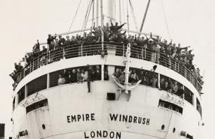
The Windrush - information
The Windrush was an old German boat that was captured during the Second World War by the British
In 1948 the Windrush went to Australia to pick up immigrants and then went on to Jamaica and collected almost 500 passengers bound for England
On board were experienced cleaners, labourers, nurses, etc. – and one stowaway, who was discovered a week into the journey!

Slide 11
Task 2: Factfile
Look at this link
There are profiles with information about 7 different individuals
Get into a group
Choose one of the individuals and make a factfile about them – you can use the format on the next slide
What would you ask them if you met them?
Star student: Write a diary entry from the perspective of your chosen individual – about the day they arrived in Britain. How do you think they were feeling? What do you think they wanted?
Notes:
See slides 17-23 for the copy for the 7 individuals – if you do not have access to IT, you can print one of these out per group.

Slide 12
Factfile template
Name
Born (year)
Where from?
Reason for coming to Britain
Job
Opinions about life in the West Indies (the Caribbean)
Opinions about life in Britain
Notes:
See slides 17-23 for the copy for the 7 individuals – if you do not have access to IT, you can print one of these out per group.

Slide 13
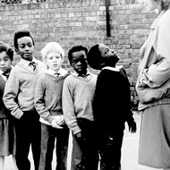
More background
Was it only the Windrush that bought Caribbeans to Britain?
No. The arrival of the Windrush was the start of a period of migration from the Caribbean to Britain that did not slow down until 1962.
By 1955, 18,000 Jamaicans had moved to Britain. This inward flow of people to settle in Britain was an important event in the history of the West Indies. It also changed the social landscape of Britain.
.

Slide 14

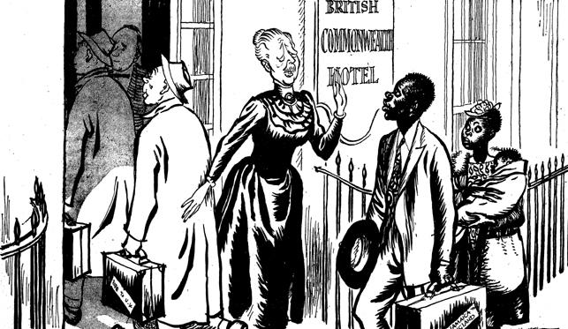
Image reflections
What do the following images tell you about how people were ‘welcomed’ in Britain?
Notes:
Read the name on the hotel on the right hand picture: remind them what we know about rights of Commonwealth Citizens due to the British Nationality Act on slide 9. How does this contrast.

Slide 15
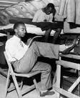
Plenary: poem ‘Windrush Child’ John Agard
Watch the video
What point does John make about the history of diversity in Britain?
What was the name of the youngest Windrush passenger?
Where did the ship arrive in Britain?
What is Vince’s first question?
Who reminds Vince to write?
Notes:
The video link: https://vimeo.com/34658318
Here for the full layout: https://www.clpe.org.uk/poetryline/poems/windrush-child
The answers:
What point does John make about the history of diversity in Britain? [that there were black people in Britain ever since Roman times]
What was the name of the youngest Windrush passenger? [Vince Reeve]
Where did the ship arrive in Britain? [Tilbury Docks – in Essex, along the Thames]
What is Vince’s first question? [Will things turn out alright?]
Who reminds Vince to write? [His Grandma]

Slide 16
1) Queen _______________ is considered the first monarch to oversee the empire.
2) Due to empire connections there have been people from all round the world living in Britain for centuries. For example in ____________ England there were several thousand black people in different towns.
3) Diverse communities in ________________ resisted racist rioting in 1919, asserting their right to be British.
4) Tens of thousands of _____________ from the empire and commonwealth fought in the two world wars. There is a statue to commemorate this in Hyde Park.
5) All residents of the British Empire and Commonwealth were officially British citizens and could get a British __________ .
6) Britain recruited many workers from the empire and commonwealth in the late 1940s and 1950s to help with ________________________
7) Not everyone welcomed the newcomers and change. There were many incidents of __________ that led to growing tensions between communities in the second half of the 20th century.
8) Many trained nurses and doctors were badly needed in the __________________ and worked in hospitals and clinics.
9) British ________________also benefited, with many of the new arrivals working on trains and buses.
Notes:
The word fill exercise with the bingo words

Slide 17
Arthur Curling
I came to England first in 1944 in the Air Force. I returned back to Jamaica in 1946 after spending two years there; it was too small for me. I joined the Air Force when I was 16 at the same time I left school, took my test and waited for the results. It was something beautiful at the time to all the young fellows in uniform. You think you want to be a part of something, but apart from that you can't always say why you do something, you're young, you don't stop and think of the dangers and things, you just do what you feel you want to do regardless of what your parents say. My parents did not approve in the beginning, but they had no choice at the time, but like everything else, its your life or your education, you gain an experience. I went back to JA in November 1946, the Windrush came in 1948, I returned to England, you know your parents are strict for one, now you have more freedom. After you reach a certain time in life you think you want to get away from the control of your parents.
As a matter of fact I had a reasonably good job in Jamaica and things were looking up. It just a matter of the Island is too small. You don't realise how small until after you've travelled.
One doesn't feel that you know everything, what happens, what you feel is a sense of freedom. I went to Bermuda, met a lot of Bermudans, I was in a crowd of people again, many were ex-service men … you were able to do things. I had a relation on the ship who was going to see his brother, who was studying at the time. It's difficult for me to go back, because I've never looked back, I always try to look forward in life.
I wouldn't say England been good to me, but I say it made a change in my life at the time. England was the easiest country to get into and the hardest country to get out of, for the mere fact is if you working, you never earn enough money for your fare, but at the same time you always say you always have another 10 year, 15-20 years. You get yourself involved and things. I have spent most of my life in England, I have travelled quite a lot on the continent of Africa, and I went to Liberia, Sierra Leone, South Africa, and North America. But England has something that you want to get back to; you can't put your finger on it.
There is a racism, but it's up to the individual how you counteract it. The fact is if a man say you are a black so and so, you can't say you are a white so and so. If you even get to fisticuffs, the best man win. It's true racism is more prominent with the younger generation, this generation doesn't put up with it, the way we as old colonials come here and accept it. Violence is part of the society today, and people will say the black man does that, but they never give the reasons he does it.
When black people wanted to do things in politics, there was always some excuse, but as the younger generation in the system today they are asking for more, and the younger generation had very few role models to follow. If you look at countries like Canada, where West Indians – or being Jamaican, I will refer to Jamaicans myself – went long after they start coming to England. They are much more advanced, they have a sense of being a West Indian, they don't mind you keeping your culture, and they accept it. People started going there as professionals, during the Michael Manley era, most of the cream left the island and that's what broke the political system of the island. The doctors, the lawyers, everybody want to go to Canada or America, unlike England – it was ordinary working class, the factory worker, etc. who came to England.
Notes:
Slides 17 to the end are the profiles with the information taken from the BBC site, in case your groups do not have access to the internet. You can print one of these out per group.

Slide 18
Clinton Edwards
I first came to England during the war, in the RAF. When I went back home there was no work so I decided to come back. There was a boat coming back, by the name of Windrush and it was only £28, so I paid my fare and come back. I was in the war for three years came back in 1948 on the Windrush as the opportunity for jobs in this country was better than back home in Jamaica.
After the end of the war, I got demobbed; I had to go back home. Coming back to England was quite pleasant, after I'd been before. I didn't quite know what to expect. A lot of the other passengers asked various questions, asking what to expect, you know.
When I came back it was a bit more difficult. I was a civilian then, I had to find work. The first job I got as a welder, instead of doing welding they gave me a wheelbarrow and a shovel. After a couple of weeks my arms [laughter] were sore. So I packed it in and re-enlisted in the RAF. I knew what to expect in the RAF. I spent another eight years, three years in Egypt and Iraq. After eight years I got demobbed and I got a job with British Oxygen company as a laboratory technician doing welding of aluminium and various metals.
My life in England has been very good. I enjoy my work, and my workmates and they treat me nice. I have been back home several times on holiday. I still call Jamaica home, although I lost my parents, you know. The home is still there, my relatives live there, and I have to keep up with the repairs, but I prefer to live here. I am married, my family is here, my children, my grandchildren. I am quite happy here, you know.

Slide 19
John Richards
Well, 1948, when I leave America, went back to home. I had some money so I decided to travel, and at the time vacancy over here was not contract, so I decided to come on my own, so I came to Britain.
I knew a lot about Britain from school days but it was a different picture from that one, when you came face to face with the facts. It was two different things.
They tell you it is the 'mother country', you're all welcome, you all British. When you come here you realise you're a foreigner and that's all there is to it.
The average person knows you as a colonial and that's all. You cut cane or carry bananas and that's it. Anybody wants to diddle you, they say I just come off the banana boat and things like that.

Slide 20
Lucile Harris
I came here in 1948. My husband sent for me. He and his brother came up a year before. I reached here the 22nd June: it was a lovely day, beautiful, and they were all at the dock waiting for me. I think it was Tilbury. I was very excited. The journey took 22 days, and that was a very long time. We enjoyed the journey: I was coming up to meet my husband – I was very anxious to come and meet him, because when he left we were just married. We got married and he left the following day. Imagine how exciting it was for me.
Jamaica in 1948 was all right to me. It was quite calm, not like now. Anyway, I was living in Port Antonio, that's 60 miles from Kingston, so we were all living happily with everyone. If my husband had not sent for me, I would not have come at that point, maybe later. It was a big troop boat, Empire Windrush, and you have lots of soldiers, and lots of people coming to England, and the reason why it took such a long time was something happened to one of the engines.
They went to Tampico and spent about three or four days there and after that we pass by Havana but we didn't dock. Then on to Bermuda and we spend another four days there, where we did land and the people there were very nice, they received us and they had a party and took us places. There were lots of men, more men than women, what I can remember now – there was a woman that stowed away on the boat, a woman you know, they found her and, she got VIP treatment, I saw her and spoke to her. She went to Birmingham. When I came to England I live in Brixton, near the market. I tell you when I came here there were hardly any buildings standing and far as you can look it bomb and burn outright through and through. My husband sorted out a place to live, before he sent for me.
Well, when I was in JA they said this is a very dark country, so it was different: the houses were all smashed because of the war, it was 1948 and war had finished in 1945. So you can imagine how it was; anyway we get together and we live together and started having our children. I had five children: three boys and two girls. One girl lives in Germany and the others are here. The first boy is living in Milton Keynes; he has a lovely house there. I have no regrets about coming here, because my family is all here, far cousins and all that, all what I am interested in is here, all my children. Bringing up my children and looking after my husband and all that, that's occupied my time.
He went home and come back and took sick and he died, and I couldn't just pick myself up and go home and leave my kids here like that. Well, I am glad that my husband sent for me, here anybody come to this country they can make a good life, it’s a nice country, it cold, it's different, but you can live happily; that's all I'm saying. I'm only sorry he is not around. But I live a good life, a good life, a clean life, and I am pleased with it.

Slide 21
Mr Oswald 'Columbus' Denniston
Word went round that this boat was taking passengers for a cheap fare £28.10 shillings to go to Britain. It was common knowledge that there was work in Britain, just after the war. The war ended three years earlier. So there was a lot of scope. It took me a week to wind things up to travel.
I had no ties: I wasn't married or anything like that. I come from Montego Bay, Jamaica. I knew no one in England. I had travelled before to America and Panama. I had no idea what I was coming to.
I was self-employed in Montego Bay. I trade now as 'Columbus'. At Montego Bay, there were near 600 people on the voyage: some were demobbed service men and women, the rest were like me, never been in the services. I can remember some of the people I travelled with, if I see them, but I don't know where they are now. All in all, it was a good journey to Britain for me. Yeah, it was.

Slide 22
Sam King
I was born in Jamaica in 1926. The 'mother country' was at war with Nazi Germany , and I did believe in the British Empire. I as a young man volunteered to contribute and fight Nazi Germany and by the Grace of God we won. It was a close thing, for example during Dunkirk a lot of people don't realise that Britain stood alone for nearly two years against tyranny. We as part of the former British Empire volunteered and contributed and I am glad I did that.
We came on the SS Cuba, which was a freight boat. The main thing is at that time you had the German Wolf pack, the submarines, and for every three ships left the American coast to Europe one is still underneath the sea. So we had to go far north, to Iceland; it was very cold and it was winter. So it was not a good journey. That was not important; what was important, was that we arrived safely. I was shocked: although Britain was at war, we assumed that the head of the Empire would be flourishing. Of course we learnt about rations, but when you realise you could not go into the shop and buy a loaf, it hit you. Secondly, the people did not have much things. The average English man in those days had one working suit, and a suit to dress to go to the pub on Sundays.
Things were very bad, about 15% of the British Isles were bombed – for example, places like London Bridge, for a quarter of a mile each side, it was flattened. Many people living in the country were not living in houses, they were living in huts in the woods. It was terrible, but they had the will to win, and that was good, and we became a part of it.
Coming back on the SS Windrush to England, in those days, the second day in England I went to Balham Labour Exchange and I was offered five jobs. Today the young man growing up, unless he is technically and academically skilled, his chance of employment is very bad.
I came with my own directive. If someone want to leave, let them leave, but I have been here during the war fighting Nazi Germany and I came back and help build Britain.
Sad to say the Right Honourable Creech Jones, he was the Minister of the Colonies, stated that we would not stay longer than one year. We are here and I and my people are here to stay.

Slide 23
Vince Reid
My parents brought me on the Windrush – I had no choice in the matter. They didn't have to – it was obvious they came in search of a better life, better opportunities. It was quite a devastating experience. I was 13 when I arrived so I wasn't a man, I was a boy. Most of the people on the Windrush were men. I had never been out of Kingston, same as for anybody: to go on this big ship, for all those days it was quite an experience.
I went to school in King’s Cross. I never associated with white people in any significant degree, and then school I came across real hostility. I mean to say I had no friends for several years – that wouldn't be far from the truth.
I only had friends when I had gone through the Air Force and came out. I joined the Air Force when I was sixteen, what they call a boy entrant – an Air Force apprentice. By the time I came out there were more black people in this country.
I am 62 years old now. I have been here 50 years. I would prefer to live here. Well, my family is here, my wife, my grandchildren are here. I have no significant roots in Jamaica. I have been back to Kingston several times. My circumstances were significantly different to everyone else's, but personally I like England, it's a nice place to live. It's not to say it doesn't have its problems, racism and so on.

