Slide 1
Notes:
A Migration Museum Project scheme of work

Slide 2
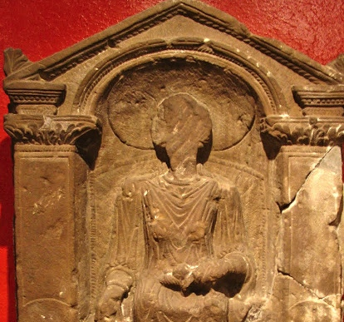
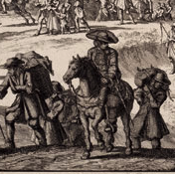
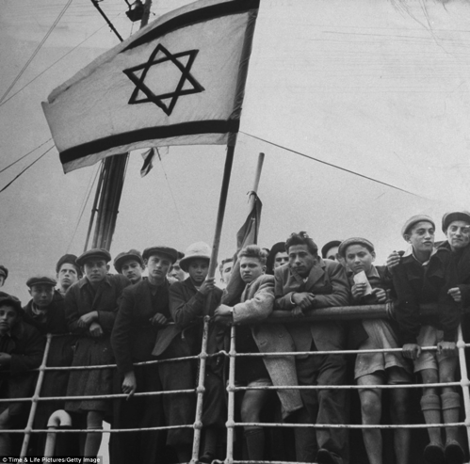
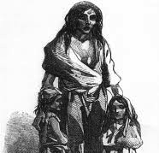
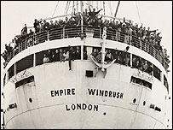
Unpacked to stay
When did Britain become a home?
Six immigration stories
Notes:
This lays out the lessons for the unit. Each circle contains an image to illustrate the theme for that lesson.
Lesson 1= introduction
Lesson 2 (circle 1) = Roman Britain
Lesson 3 = The Huguenots
Lesson 4 = Jewish immigration
Lesson 5 = The Irish diaspora
Lesson 6 = Commonwealth immigration
Lesson 7 = Current migration debates

Slide 3
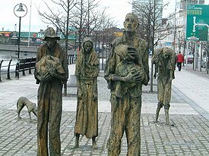
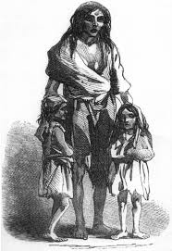
Unpacked to stay
When did Britain become a home?
Enquiry question: Famine or fortune? Looking at the reasons for the Irish diaspora
Illustrated London
Notes:
This is the enquiry question for the lesson. Differentiated aims on next slide.

Slide 4
Aim: To understand some reasons for the growth of the Irish diaspora
I will be able to analyse some causes and consequences of Irish migration
I will be able to demonstrate understanding of one reason for Irish emigration
I will understand that many people have left Ireland over the centuries
Notes:
We have chosen to lay out the Lesson Objective in this differentiated way each lesson. Feel free to edit to fit with your school system.

Slide 5
Key words
Migration: people moving from one place to another
Multicultural: A society containing several different cultural or ethnic groups
Emigration: The act of leaving one country to go and live in a different country
Diaspora: A scattered population with a common origin in a smaller geographic area. Diaspora can also refer to the movement of the population from its original homeland
Notes:
Gradually the keywords for this unit will increase in number. You might choose to put all keywords and definitions on the wall during the unit.

Slide 6
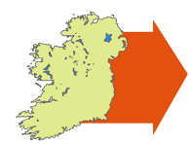
Task 1: Do now 1 – what connects these three pictures?
Notes:
Answer: Potato Famine in Ireland leading to mass emigration in the 1850s

Slide 7
Do now 2 – listen to an Irish folk song
The link is here
What do you hear?
What does the Irish man think of life in England?
Are there any words you don’t understand?
Notes:
‘Mountains O’Mourne’ sung by Don McLean: https://www.youtube.com/watch?v=iEZIKSm78k8
4 verses – lyrics on next slide

Slide 8
‘Mountains O’Mourne’ lyrics
Oh, Mary, this London’s a wonderful sight
With people here working by day and by night
They don’t sow potatoes nor barley nor wheat
But there’s gangs of them diggin’ for gold in the street
At least when I asked them, that’s what I was told
So I just took a hand at this diggin’ for gold
But for all that I’ve found there, I might as well be
In the place where the dark Mourne sweeps down to the sea
I believe that when writin’ a wish you expressed
As to how the fine ladies of London were dressed
But if you’ll believe me, when asked to a ball
They don’t wear no tops to their dresses at all
Oh, I’ve seen them myself and you could not in truth
Tell if they were bound for a ball or a bath
Don’t be startin’ them fashions now, Mary McRee,
In the place where the dark Mourne sweeps down to the sea
There’s beautiful girls here, oh, never you mind
Beautiful shapes Nature never designed
Lovely complexions of roses and cream
But let me remark with regard to the same
That if at those roses you venture to sip
The colours might all come away on your lip
So I'll wait for the wild rose that's waitin’ for me
In the place where the dark Mourne sweeps down to the sea
You remember young Diddy McClaren, of course,
But he’s over here with the rest of the force
I saw him one day as he stood on the strand
Stopped all the traffic with a wave of his hand
As we were talking of days that are gone
The whole town of London stood there to look on
But for all his great powers, he’s wishful like me
To be back where the dark Mourne sweeps down to the sea
Notes:
It reads downwards: v1 top left, v2 bottom left, v3 top right, v4 bottom right

Slide 9
Lyric focus:
‘Oh Mary, this London’s a wonderful sight,
With people here working by day and by night
They don’t sow potatoes nor Barley nor Wheat
But there’s gangs of them diggin’ for gold in the street’
Notes:
Questions about this verse to discuss as a class:
Oh, Mary, this London’s a wonderful sight [what does this suggest about how the Irish saw London?]
With people here working by day and by night [what does this suggest about jobs in Ireland?]
They don’t sow potatoes nor barley nor wheat [what might you guess about life in Ireland from this? How does it connect with the image linking you did?]
But there’s gangs of them diggin’ for gold in the street [are they really digging for gold? What does this suggest?]

Slide 10
Task 1: Irish immigration
Read through the worksheet carefully, with a highlighter to hand
Highlight any information or facts that you think are important
You will need the information from this sheet for the true / false activity coming up
Notes:
For this you need to have printed out the Irish immigration worksheet, and have some highlighter pens for pupils

Slide 11
True / False
On the next slides, there are some statements about what you have just learnt
Decide if they are true or false by holding up your TRUE or FALSE cards
Notes:
Pupils will need some way of indicating true and false. Hands up can work if no other option.

Slide 12
True / False
It is only in the last century that Irish people have been moving to Britain

Slide 13
False
There has been Irish migration to Great Britain from the earliest recorded history to the present
There has been a continuous movement of people between the islands of Ireland and Great Britain because of how close they are to each other
This migration has increased and decreased in response to political, economical and social conditions in both places.

Slide 14
True / False
Today 1% of British people can claim Irish ancestry (that former generations in their family were Irish)

Slide 15
False
Today, millions of residents of Britain are either from Ireland or have Irish ancestry.
It is estimated that as many as 6 million people living in the UK have an Irish grandparent (around 10% of the UK population).

Slide 16
True / False
Many Irish men fought in the British Army during the 2 World Wars

Slide 17
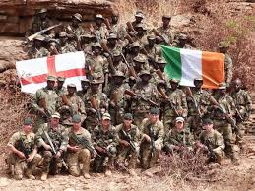
True
During the 19th and 20th centuries Irish soldiers formed a significant proportion of the British Army
Notes:
If you have a high ability class, or Irish pupils you might want to address the fact that this statement and the image are contentious for many in Ireland, and why that is.

Slide 18
True / False
Most Irish people are Roman Catholic by background

Slide 19
True
Roman Catholicism is the main religion in the Republic of Ireland. What other religions are represented?

Slide 20
True / False
The Patron Saint of Ireland is St George

Slide 21
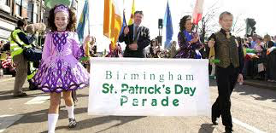
False
Saint Patrick is the patron saint of Ireland. St Patrick’s Day is widely celebrated throughout Great Britain, as a result of many British people’s ancestral links with Ireland.
Birmingham and Manchester have particularly large parades.

Slide 22
Task 2: Card sort activity
What were the consequences of the Irish potato famine?
Cut our and sort your cards into 3 columns:
Social – to do with people and their lives
Economic – to do with money
Both – equally to do with people and money
Star student: Write a paragraph explaining whether you think social consequences or economic consequences were more important. Give full reasons for your answer.

Slide 23
The card sort
1) The population of Ireland is still only half what it was in 1840 . | 2) Approximately 1 million people emigrated.
3) Many of the poorest families were evicted from houses on land they did not own and had to join workhouses. | 4) Many of those who emigrated were Irish-speaking, which led to a decrease in Irish being spoken in Ireland.
5) In Liverpool, for example, where many Irish immigrants settled following the Great Famine, anti-Irish prejudice was widespread. There were physical attacks, and often those with Irish accents or Irish names were barred from jobs, pubs and housing options. | 6) In the decades after the Famine, the age of marriage rose sharply to 28 for women and 33 for men. Low wages discouraged early and universal marriage, so as many as ¹/₃ of Irishmen and ¹/₄ of Irishwomen never married due to.
7) Gradually, as emigrants established themselves in new parts of the world, they sent money (remittances) home to those they had left behind. | 8) The famine lead to social unrest and a rebellion against English rule in 1848.
Notes:
Answers:
Both social and economic
Both social and economic
Both social and economic
Mostly social
Mostly social
Both social and economic
Mostly economic
Mostly social – and political

Slide 24
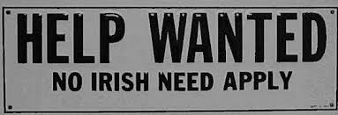
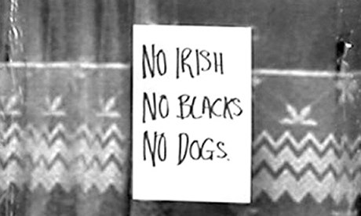
Task 3 - pictures
What do the following pictures suggest about the ‘welcome’ the Irish received once they had migrated?
Notes:
Explain that these were common signs in England – also in job adverts in newspapers etc – before race relations legislation came into place

Slide 25
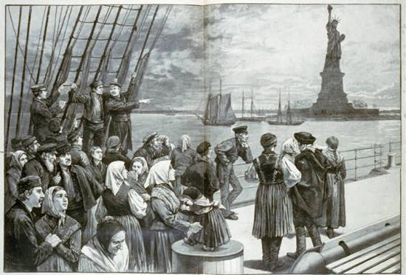
Plenary: Song
Listen to ‘Thousands are sailing’ by the Pogues
This song by the Pogues (written by Phil Chevron) is about emigration from Ireland to America during the 1880s when unemployment was 20% in Ireland.
As you listen, write down THREE ways in which the song lyrics connect to the content you have learned about today.
Notes:
Remind them they’ll know another Christmas song by the Pogues!
Link in case you need it: https://www.youtube.com/watch?v=27iJsZpQn3A
You can read the lyrics as the song rolls. You will need to explain what ‘coffin ship’ means

