Slide 1
Notes:
A Migration Museum Project scheme of work

Slide 2
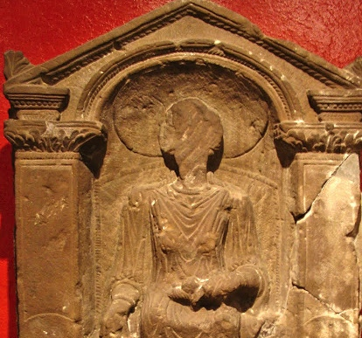
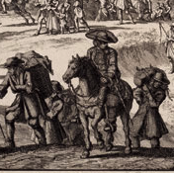
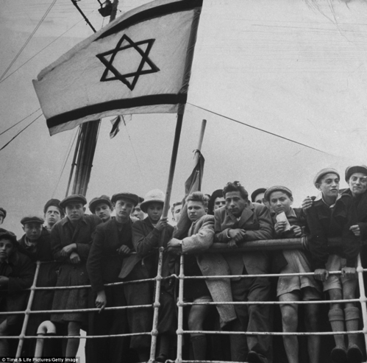
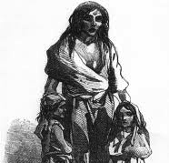
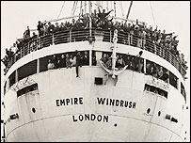
Unpacked to stay:
When did Britain become a home?
Six immigration stories
Notes:
This lays out the lessons for the unit. Each circle contains an image to illustrate the theme for that lesson.
Lesson 1= introduction
Lesson 2 (circle 1) = Roman Britain
Lesson 3 = The Huguenots
Lesson 4 = Jewish immigration
Lesson 5 = The Irish diaspora
Lesson 6 = Commonwealth immigration
Lesson 7 = Current migration debates

Slide 3
Unpacked to stay:
When did Britain become a home?
Enquiry question: Why did the Jews come to Britain?
Dmitri Kessel/Getty Images
Computer Lesson
Notes:
This is the enquiry question for the lesson. Differentiated aims on next slide.

Slide 4
Aim: To examine Jewish migration to Britain
I will be able to analyse some causes and consequences of Jewish migration to Britain
I will be able to explain why Jewish people came to Britain
I will understand that Jewish people left their countries of origin
Notes:
We have chosen to lay out the Lesson Objective in this differentiated way each lesson. Feel free to edit to fit with your school system.

Slide 5
Key words
Migration: people moving from one place to another
Multicultural: A society containing several different cultural or ethnic groups
Emigration: The act of leaving one country and going to live in a different one
Anti-semitism: Hostility to or prejudice against people or individuals because they are Jewish
Notes:
Gradually the keywords for this unit will increase in number. You might choose to put all keywords and definitions on the wall during the unit.

Slide 6
Task 1: Exploring a timeline
Log onto the MMP Jewish history timeline
Spend 5 minutes exploring the timeline. What can you learn about Jewish immigration to Britain?
As a class go through the timeline. What do you think is really interesting about the life that Jewish people have had in Britain?
Notes:
A paper timeline is available if you cannot log onto the timeline.
The link is here: https://cdn.knightlab.com/libs/timeline/latest/embed/index.html?source=1xGFSB4PXOhdGB33zSCnGABzJss6X_oIsnJK1u6W7Yf8&font=Bevan-PotanoSans&maptype=toner&lang=en&height=650

Slide 7
Task 2: Create a key events timeline
Use the online timeline to create your own timeline of Jewish history in Britain. Include 8 key events
This involves you deciding what you think are the 8 most important events
This involves you deciding to leave some events out. How will you justify your decisions?
Star student: write a paragraph explaining how you think attitudes to Jewish immigration have changed over the last 1000 years. Have we become more or less tolerant of other religions? What evidence do you have?
Historic UK
Notes:
This task demands that pupils synthesise information from the full timeline and then prioritise what they think is most important. They can work alone or in pairs depending on your class and IT access. They could write their own timeline in their books with just the headings of the ‘events’ on there.

Slide 8
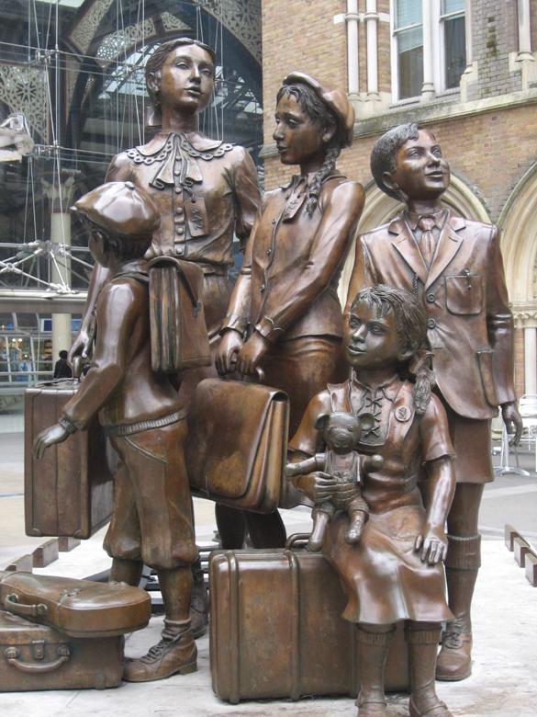
Plenary: The Kindertransport
Notes:
This plenary takes one episode of Jewish immigration – Kindertransport. For a summary of the Kindertransport, or to refresh your memory, look at this link: https://en.wikipedia.org/wiki/Kindertransport

Slide 9
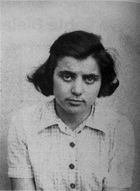
Plenary: Profile 1: Karen Gershon
Poet Karen Gershon was born in Bielefeld, Germany, in 1923. Her sister Anne was born in 1921 and Lise in 1922.
Her father, Paul Gershon-Löwenthal (b. 1890), an architect, served in the German army for many years and considered himself a German citizen. His wife, Selma (b. 1893), came from a traditional Jewish family.
Karen’s maternal grandfather, Adolf Schönfeld, was head of the Jewish community of Bielefeld and the first of its members to be murdered by the Nazis.
After the pogrom of 9 and 10 November 1938 (“Kristallnacht”), the burning of synagogues and a wave of attacks on Jews, Karen Gershon and her sisters were sent to England with the Kindertransport.
Notes:
To show power

Slide 10
Plenary: Karen’s story
Read through Karen’s poem (on the next slide) together as a class
What 3 things can it tell you about her story?
In what ways is Karen’s story similar to those of some of the other Jewish immigrants we have learnt about today? And in what ways it is different?
Notes:
To show power

Slide 11
Plenary: Karen’s poem
It was an ordinary train travelling across
Germany which gathered and took us
away those who saw us may have
thought that it was for a holiday not
being exiled being taught to hate what
we had loved in vain brought us lasting
Injury
Our parents let us go knowing that who
stayed must die but kept the truth from
us although they gave us to reality did
they consider what it meant to become
orphaned and not know to be
emotionally freed when our childhood
seeds were spent
When we went out of Germany
carrying six million lives that was Jewish
history but each child was one refugee
we unlike the Egyptian slaves were
exiled individually and each in
desolation has created his own
Wilderness
This race-hatred was personal we were
condemned for what we were no one
escaped the ritual from which we rose
inferior the blood-guilt entered every
home till daily life was a pogrom we
who were there are not the same as
those who have no wreck to share
Home is where some know who you
are The rescue was impersonal it was
no one's concern what use we made of
the years given us one should not ask of
children who find their survival natural
gratitude for being where ten thousand
others have come too
At Dovercourt the winter sea was like
God's mercy vast and wild a fever to a
land-locked child it seemed fire and
cloud to me the world’s blood and my
blood were cold the exiled Jew in me
was old and thoughts of death appalled
me less than knowledge of my
loneliness
My mother sold my bed and chair while
I expected to return yet she had kept
me close to her till I saw our temple
burn it was not for her sake but mine
she knew I was unripe fruit and that
exile was a blight against which one
prepared in vain
People at Dovercourt were gay as if
they thought we could forget our homes
in alien play as if we were not German
Jews but mealtimes were a market-
place when sudden visitors could
choose although we were not orphaned
yet a son or daughter by their face
My childhood smoulders in the name of
the town which was my home all we
were became no more than answers on
a questionnaire at Dovercourt we were
taught that our share of the Jewish fate
had not been left behind but was the
refugee life facing us
Notes:
Read poem as a class and discuss parts that aren’t clear.

