Slide 1
Notes:
A Migration Museum Project scheme of work. This lesson is created in partnership with Windrush Foundation (after consultation with Arthur Torrington).

Slide 2
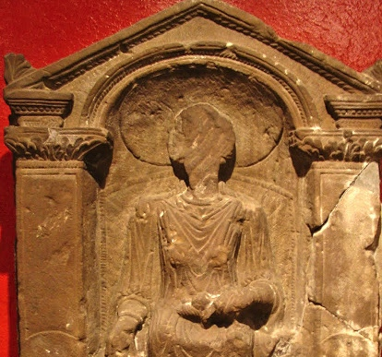
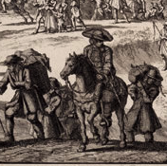
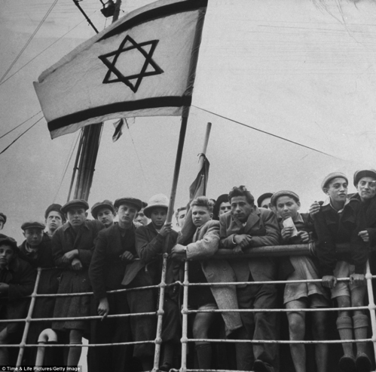
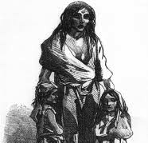
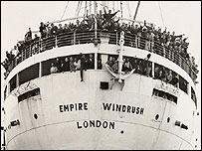
Unpacked to stay
When did Britain become a home?
Six immigration stories
Notes:
This lays out the lessons for the unit. Each circle contains an image to illustrate the theme for that lesson.
Lesson 1= introduction
Lesson 2 (circle 1) = Roman Britain
Lesson 3 = The Huguenots
Lesson 4 = Jewish immigration
Lesson 5 = The Irish diaspora
Lesson 6 = Windrush and legacy
Lesson 7 = Current migration debates

Slide 3
Windrush Foundation information
This lesson is produced in partnership with Windrush Foundation which is a registered Charity established in 1996. The organisation plays the leading role in preserving the history of the arrival of the first post-war wave of Caribbean settlers at Tilbury Docks, Essex, on 22nd June 1948.
The Foundation’s mission is to promote good community relations and to endeavour to eliminate discrimination on the grounds of race, encouraging equality of opportunity for all. It delivers heritage projects, programmes and initiatives which highlight African and Caribbean people's contributions to the arts, public services, commerce and other areas of socio-economic and cultural life in Britain.
Notes:
For more information or to contact the foundation see: http://www.windrushfoundation.org/

Slide 4
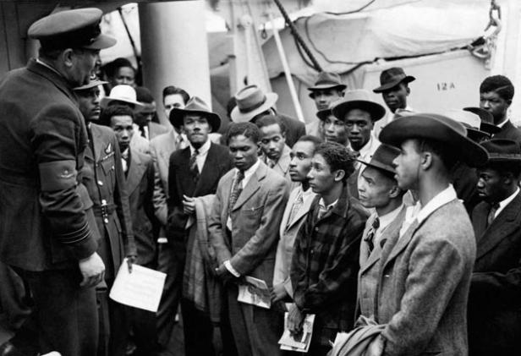
Unpacked to stay
When did Britain become a home?
Enquiry question: Were those who arrived on the Windrush welcomed in Britain?
Notes:
This is the enquiry question for the lesson. Differentiated aims on next slide.

Slide 5
Aim: To understand the context of the arrival of Windrush and the reception of those on board.
I will be able to analyse the context of people arriving on the Windrush and their experiences in 1950s Britain
I will be able to describe some of the reasons for people leaving the Caribbean and some reactions to their arrival and settling
I will be able to explain that many people left the Caribbean and arrived to live in Britain in 1948 onwards
Notes:
We have chosen to lay out the Lesson Objective in this differentiated way each lesson. Feel free to edit to fit with your school system.

Slide 6
Key words
Empire: When one country rules over other countries (e.g the British Empire)
Colonies: In this context colonies refers to countries, regions and islands (such as India and parts of the ‘West Indies’) that were part of the British Empire and controlled from Great Britain
Commonwealth: An international association consisting of the UK together with some states that were previously part of the British Empire
Racism: Prejudice or discrimination directed against someone of a different race based on the belief that one’s own race is superior
Notes:
Gradually the keywords for this unit will increase in number. You might choose to put all keywords and definitions on the wall during the unit.

Slide 7
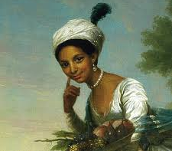
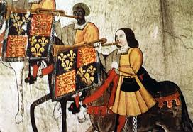
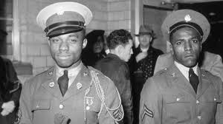
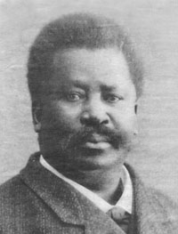
Task 1: Do now – Match-up activity
There is a common misconception that there was no black presence in Britain before the arrival of the Windrush. This is so because the Windrush and its legacy are quite well known, and because less is known about pre-1948 black Britons. Match up the following images with the correct caption to learn more.
1] | 2] | 3]
4] | 5]
Notes:
Pic 5 copyright: Camille Silvy 1862, National Portrait Gallery London
The rest are from Google images.

Slide 8
Task 1: Do now – match 6 images and captions
1] John Blanke was a musician in the King’s court in the 1500s, possibly bought over by Catherine of Aragon from Spain. He served in the court of Henry VI and Henry VIII | 2] This photo was taken in 1862 of Sarah Forbes Bonetta. She was orphaned in her native Nigeria during warfare, then enslaved but liberated and became goddaughter of Queen Victoria. She married a Nigerian in Britain, and died of TB in 1880 | 3] This image shows the first non-white circus owner in Britain – Pablo Fanque – born in Norwich in 1810. His circus was the most popular in Britain for 30 years during the Victorian period
4] This is a painting of Dido Belle, born to an enslaved African woman and a British captain in the British West Indies in 1761 and bought back to England where she grew up with the captain’s relatives in North London | 5] This shows servicemen from the then British West Indies in the British Royal Air Force in World War 2. Thousands served and died in the war. Many were stationed and trained in Britain
Notes:
Answers:
pic 1 = caption 4 – for more info: https://en.wikipedia.org/wiki/Dido_Elizabeth_Belle
pic 2 = caption 1 – for more info: https://en.wikipedia.org/wiki/John_Blanke
pic 3 = caption 5 – for more info: http://www.bbc.co.uk/news/uk-32703753
pic 4 = caption 3 – for more info: https://en.wikipedia.org/wiki/Pablo_Fanque
pic 5 = caption 2 – for more info: https://en.wikipedia.org/wiki/Sara_Forbes_Bonetta

Slide 9
Task 2: Read together: Background information
Many Commonwealth citizens had fought for Britain during WW2 and many had lost their lives. They had shown how important they were to the British Empire
After WW2 Britain needed workers in many industries – many men had died. The ‘West Indies’ was less economically developed and many wanted to leave the islands and the poverty there
In 1948, the British Nationality Act gave 800 million people in Commonwealth countries the right to claim British Citizenship
The NHS was launched in 1948 and needed workers to get it going. It advertised regularly in Commonwealth countries to attract new workers
Notes:
Thanks to TES user CourtneyOakes9 for inspiration for some of the following pages

Slide 10
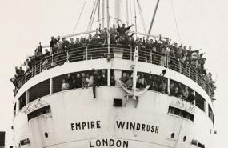
The Windrush - information
The Empire Windrush was a German ship that was taken by the British after WW2
In 1948 the Windrush sailed from the Caribbean taking more than 500 passengers bound for England
On board there were hundreds of multi-ethnic passengers including men and women, young and old, former service-men, and musicians

Slide 11
Task 2: Push / Pull factors
Why did people get onto the Windrush?
Quickly use the background information we’ve just read to divide answers into push and pull factors.
Push factors | Pull factors
Notes:
Example answers:
Push factors = economic problems in the West Indies, less education opportunities, climatic challenges
Pull factors = connection with the ‘mother country’ through the armed forces, better economic and education opportunities, jobs advertised, adventure,

Slide 12
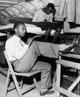
Task 3: poem ‘Windrush Child’ by John Agard
Watch the video
What point does John make about the history of diversity in Britain?
What was the name of one of the youngest Windrush passengers?
Where did the ship arrive in Britain?
What is Vince’s first question?
Who reminds Vince to write?
Notes:
The video link: https://vimeo.com/34658318
Here for the full layout: https://www.clpe.org.uk/poetryline/poems/windrush-child
The answers:
What point does John make about the history of diversity in Britain? [that there were black people in Britain ever since Roman times]
What was the name of the youngest Windrush passenger? [Vince Reeve]
Where did the ship arrive in Britain? [Tilbury Docks – in Essex, along the Thames]
What is Vince’s first question? [‘Will things turn out alright?’]
Who reminds Vince to write? [His Grandma]

Slide 13
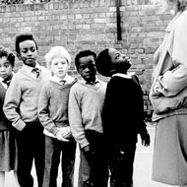
Task 3 - write a diary entry
Read Vince’s story on the last 3 slides of this lesson
Imagine Vince’s first day of school in Kings Cross, London.
you might include:
reflections on his journey on the Windrush
the reasons his adopted parents left Jamaica
what he misses about Jamaica
what he is looking forward to about school and life in Britain
some of the reactions of other pupils and the teachers to his arrival at the school – and why
what he hopes for the future in Britain
.

Slide 14
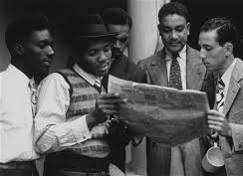
More background – read together
Another misconception is that the Windrush is the only ship that bought people across from the Caribbean. But really the arrival of the Windrush was the start of a period of migration from the Caribbean to Britain that did not slow down until 1962 when the Commonwealth Immigrants Act came into force.
By 1955, more than 18,000 Caribbean migrants had settled in Britain. This inward flow of people was an important event and it changed the social landscape of Britain.

Slide 15
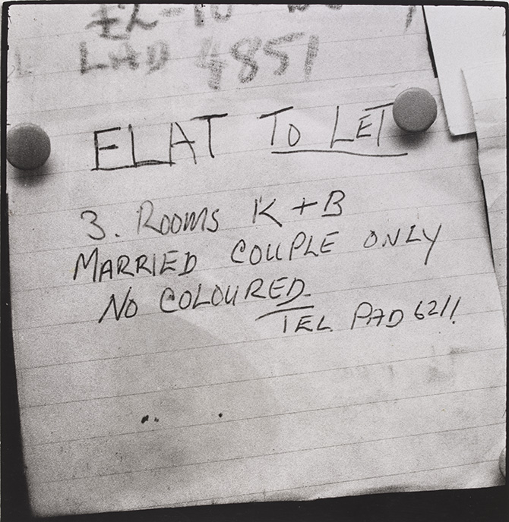
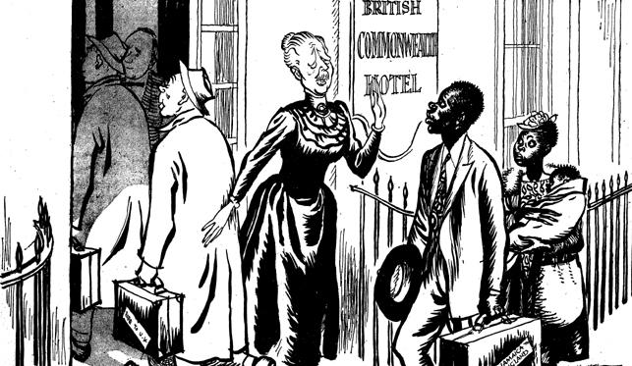
Image reflections
What do the following images tell you about how people were ‘welcomed’ in Britain?
Notes:
Image 1: Room to let, Notting Hill, c. 1966, Charlie Phillips: http://www.migrationmuseum.org/100imagesgallery/room-to-let/
Image 2: Read the name on the hotel on the right hand picture: remind them what we know about rights of Commonwealth Citizens due to the British Nationality Act. How does this contrast with that law? What is happening in the image?
NB: Coloured is an ethnic descriptor that has historically used in the USA and British Commonwealth countries. After the civil rights movement in the USA the term ‘black’ became more popular. From the 1970’s the majority of people with African origin in the UK also adopted the word ‘black’.

Slide 16
Plenary – agreement line
Those that arrived on the Windrush were fully welcomed in Britain
From your learning this lesson how far do you agree with this statement?
Notes:
Ask pupils to arrange themselves in a line from one side of the classroom to the other from ‘strongly disagree’ to ‘strongly agree’ and be ready to justify their position along the line with statements or with references to sources, where possible.

Slide 17
Vince Reid’s story:
Vincent Albert Reid was born on 9th January 1935 in Jamaica and brought up in Kingston by adopted parents. At the age of 13 he migrated with them to England travelling on the ship Empire Windrush which disembarked its passengers at Tilbury Docks, Essex, on 22nd June 1948.
Life for him at secondary school was unpleasant. He experienced bullying because of his Jamaican accent and the colour of his skin. This led him to become truant and consequently he left school without any certificates. Vince was employed by the Post Office, but at aged 16, he joined the Royal Air Force as a mechanic, serving temporarily overseas in Malaya. After four years’ service and at the age of 19, he bought himself out of the RAF. He later found work at Heathrow Airport, but left when his employer refused to give him time-off to attend a further education institution.
Notes:
Print these 2 slides out as a worksheet
Info from the Windrush Foundation

Slide 18
Vince Reid’s story continued:
It was in late 1960s that he met and married Elizabeth Evans, an English woman, who fully supported his efforts to study at university level. Vince was accepted as a mature student aged 35 to read African history at Sussex University. After graduating in 1973 he studied for a master's degree at the School of Oriental and African Studies (SOAS) in London.
In 1974, he joined Brixton College of Further Education (now part of Lambeth College) in South London. There he became a pioneering lecturer on Caribbean and African history and served as a mentor to staff and students. Vince took early retirement in 1995 as a senior lecturer, and in 1998 played an important role in the national commemoration of the 50th anniversary of the arrival of the Empire Windrush. Vince died suddenly aged 66 on 11th May 2001.
Notes:
Print these 2 slides out as a worksheet
Info from the Windrush Foundation

Slide 19
Vince Reid – in his own words
“My parents brought me on the Windrush – I had no choice in the matter. They didn't have to – it was obvious they came in search of a better life, better opportunities. It was quite a devastating experience. I was 13 when I arrived so I wasn't a man, I was a boy. Most of the people on the Windrush were men. I had never been out of Kingston, same as for anybody: to go on this big ship, for all those days it was quite an experience.
I went to school in King’s Cross. I never associated with white people in any significant degree, and then school I came across real hostility. I mean to say I had no friends for several years – that wouldn't be far from the truth.
I only had friends when I had gone through the Air Force and came out. I joined the Air Force when I was sixteen, what they call a boy entrant – an Air Force apprentice. By the time I came out there were more black people in this country.
I am 62 years old now. I have been here 50 years. I would prefer to live here. Well, my family is here, my wife, my grandchildren are here. I have no significant roots in Jamaica. I have been back to Kingston several times. My circumstances were significantly different to everyone else's, but personally I like England, it's a nice place to live. It's not to say it doesn't have its problems, racism and so on.”
Notes:
This extract is from: https://www.theguardian.com/media/2001/may/24/broadcasting.schools

