Slide 1

Notes:
A Migration Museum Project scheme of work

Slide 2
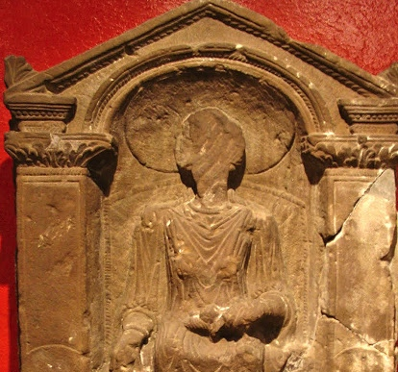
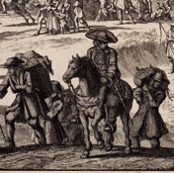
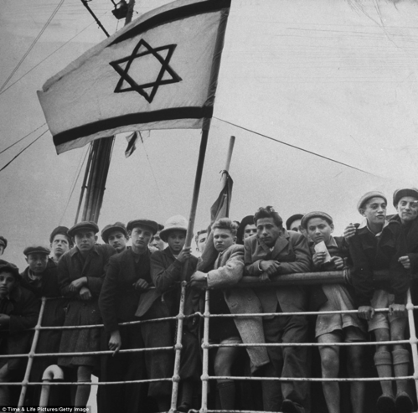
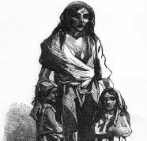
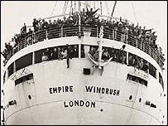

Unpacked to stay
When did Britain become a home?
Six immigration stories
Notes:
This lays out the lessons for the unit. Each circle contains an image to illustrate the theme for that lesson.
Lesson 1= introduction
Lesson 2 (circle 1) = Roman Britain
Lesson 3 = The Huguenots
Lesson 4 = Jewish immigration
Lesson 5 = The Irish diaspora
Lesson 6 = Commonwealth immigration
Lesson 7 = Current migration debates

Slide 3
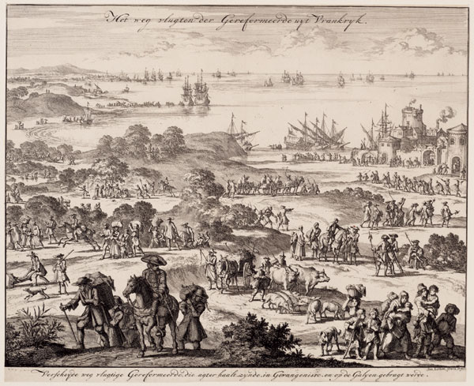
Unpacked to stay
When did Britain become a home?
Jan Luyken, 1696
Enquiry question:
Why was Britain a safe haven for the Huguenots in the early 1700s ?
Notes:
This is the enquiry question for the lesson. Differentiated aims on next slide.

Slide 4
Aim: To understand some of the reasons for the Huguenots coming to Britain
I will be able to analyse some causes and consequences of the Huguenots arriving in Britain
I will be able to demonstrate understanding of why the Huguenots emigrated
I will understand that the Huguenots left France and came to Britain in the early 1700s
Notes:
We have chosen to lay out the Lesson Objective in this differentiated way each lesson. Feel free to edit to fit with your school system.

Slide 5
Key words
Migration: people moving from one place to another
Multicultural: A society containing several different cultural or ethnic groups
Emigration: The act of leaving one country to go and live in a different country
Notes:
These are 3 Keywords for the lesson. You may want to add more.

Slide 6
Task 1: Do now – understanding reasons for emigration
Imagine the UK government has said that you can no longer practise your religion safely
What would you do?
Fight back
Change your religion
Hide your religious practices
Move to a country where you can do what you want
Discuss these options with your partner. What would the possible consequences of these actions be?
Notes:
This starter is to get pupils thinking about religious freedom. If your pupils’ reaction is that they don’t have a religion, either ask them to imagine if they did, or alter the task so that they are not allowed to listen to the music they like (it is banned) or watch or play football etc.

Slide 7
What is a Huguenot?
Watch the video (0:00 – 2:23)
After watching the video make a short definition of the word Huguenot
Some of the ideas are quite difficult so have a Q+A with your teacher to make sure you all have a good understanding of the word
Notes:
The video link: https://www.youtube.com/watch?v=xOOOym_4t78
An academic explains in some detail what a Huguenot is. You may want to pre-listen to this and flag up some key words (give each a sheet with key images and words as bingo) or similar to engage pupils more.

Slide 8
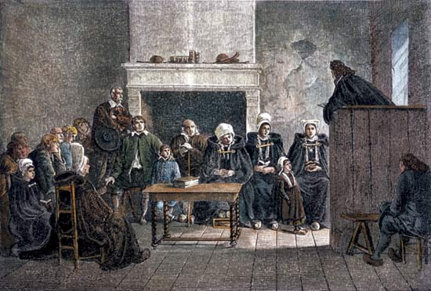
Activity 1: The Huguenots
1. Fill in the question table on the Huguenots, using the information sheet provided.
The Granger Collection, New York
Star student: Design an activity to teach a year 6 student about the Huguenots. How can you make the information clear to them? How can you make it fun too?
Try it out with your partner if they’ve finished the worksheet too.
Notes:
You will need the worksheet provided with this lesson powerpoint
The Star Student task is for higher ability pupils once they have completed the table on the next slide

Slide 9
Activity 1: The Huguenots
Where did the Huguenots come from?
When did they leave?
Why did they leave?
What negative impact did their leaving have on the country they came from?
Where did they settle?
Why did some people dislike them?
Why did the upper classes like them?
What had they done by the late 18th century?
Why were the French communities in London so different from one another?
Notes:
You can either print this off as a worksheet or project it onto board and pupils write answers in full sentences into their books.

Slide 10

Activity 2: Writing a letter
Imagine you were a Huguenot arriving in London in 1701. Write a letter to your former (Catholic) boss back in France letting him know how you are doing and what your life is like in England.
You could include:
How you felt about leaving France
How you were treated when you arrived in London
What work you are doing
Who appreciates your work
Who doesn’t appreciate your work
Reflections on other French communities in other towns in England
Notes:
This can be set for homework depending on pace of lesson and how much detail you would like to see.

Slide 11
Plenary: Change / continuity
Have immigrants arriving in Britain always been given the same treatment?
How does the story of modern immigrants compare with the story of the Huguenots?
Write down one similarity and one difference between the story of the Huguenots and the stories of recent (last 10 years) immigrants to Britain that you know of.
Notes:
Here you can link back to the discussion you may have begun at the start of the lesson with the image on slide 2. Project up some images and headlines associated with recent immigration. You might prompt by asking about push/pull factors, how migrants travel, their reception on arrival, their skills, their reception as they settle etc.

